Slide 1
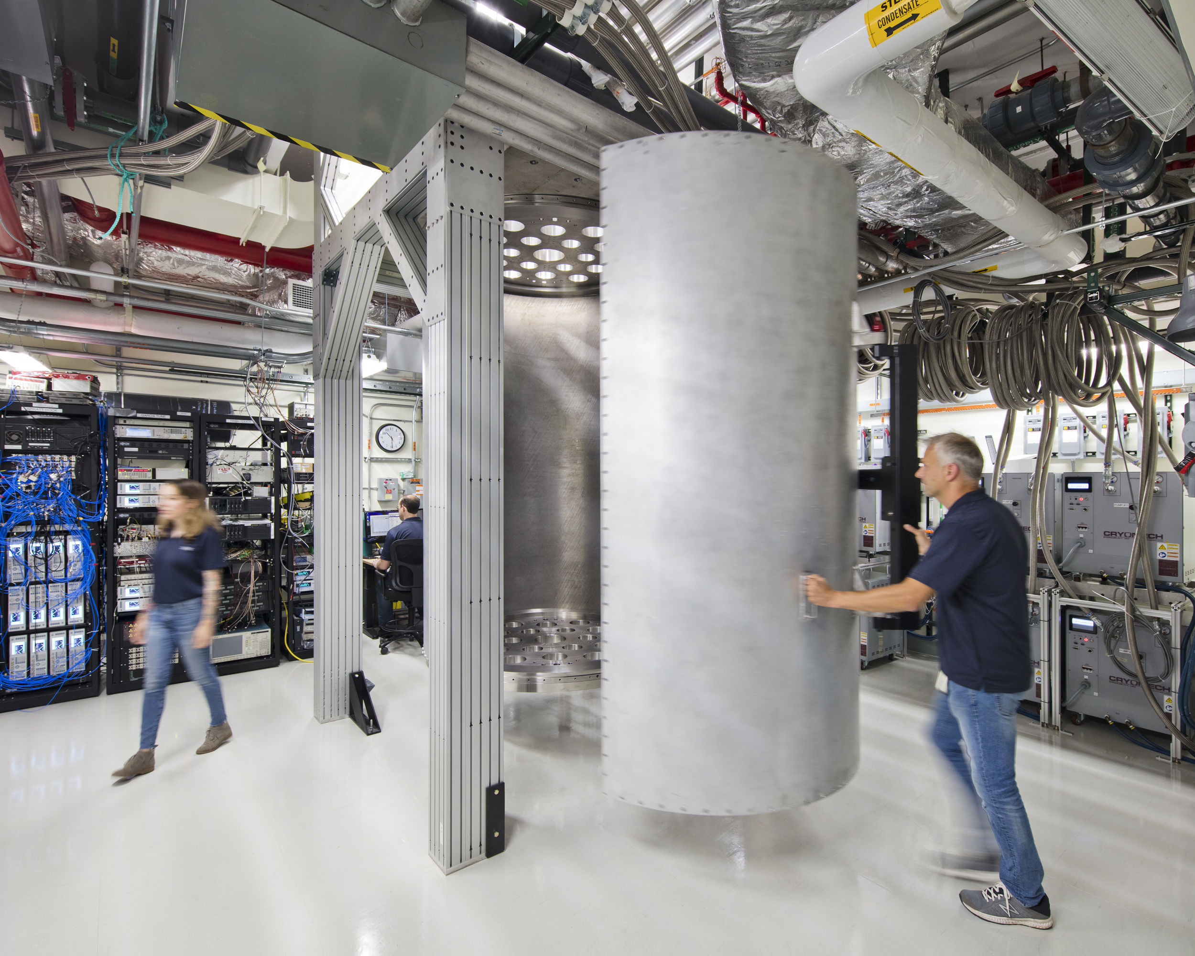
IBM Quantum computing Journey
IBM Quantum Support Team
Notes:
It will house the upcoming Condor 1,121 qubit processors which we believe will pave the path to 1M qubits and beyond.

Slide 2
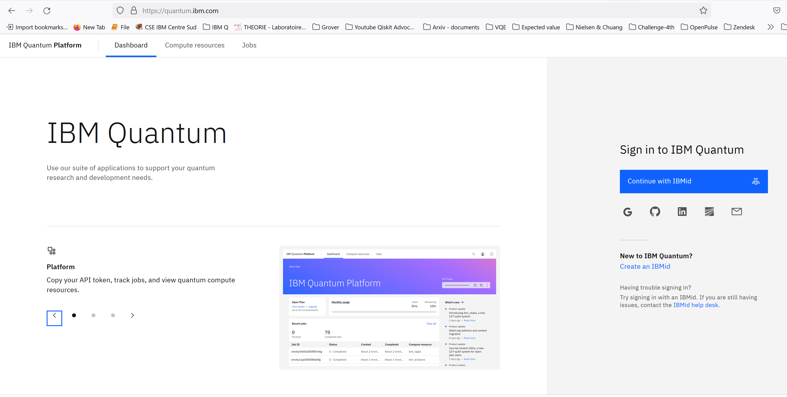
IBM Quantum Sign in
IBM Quantum

Slide 3
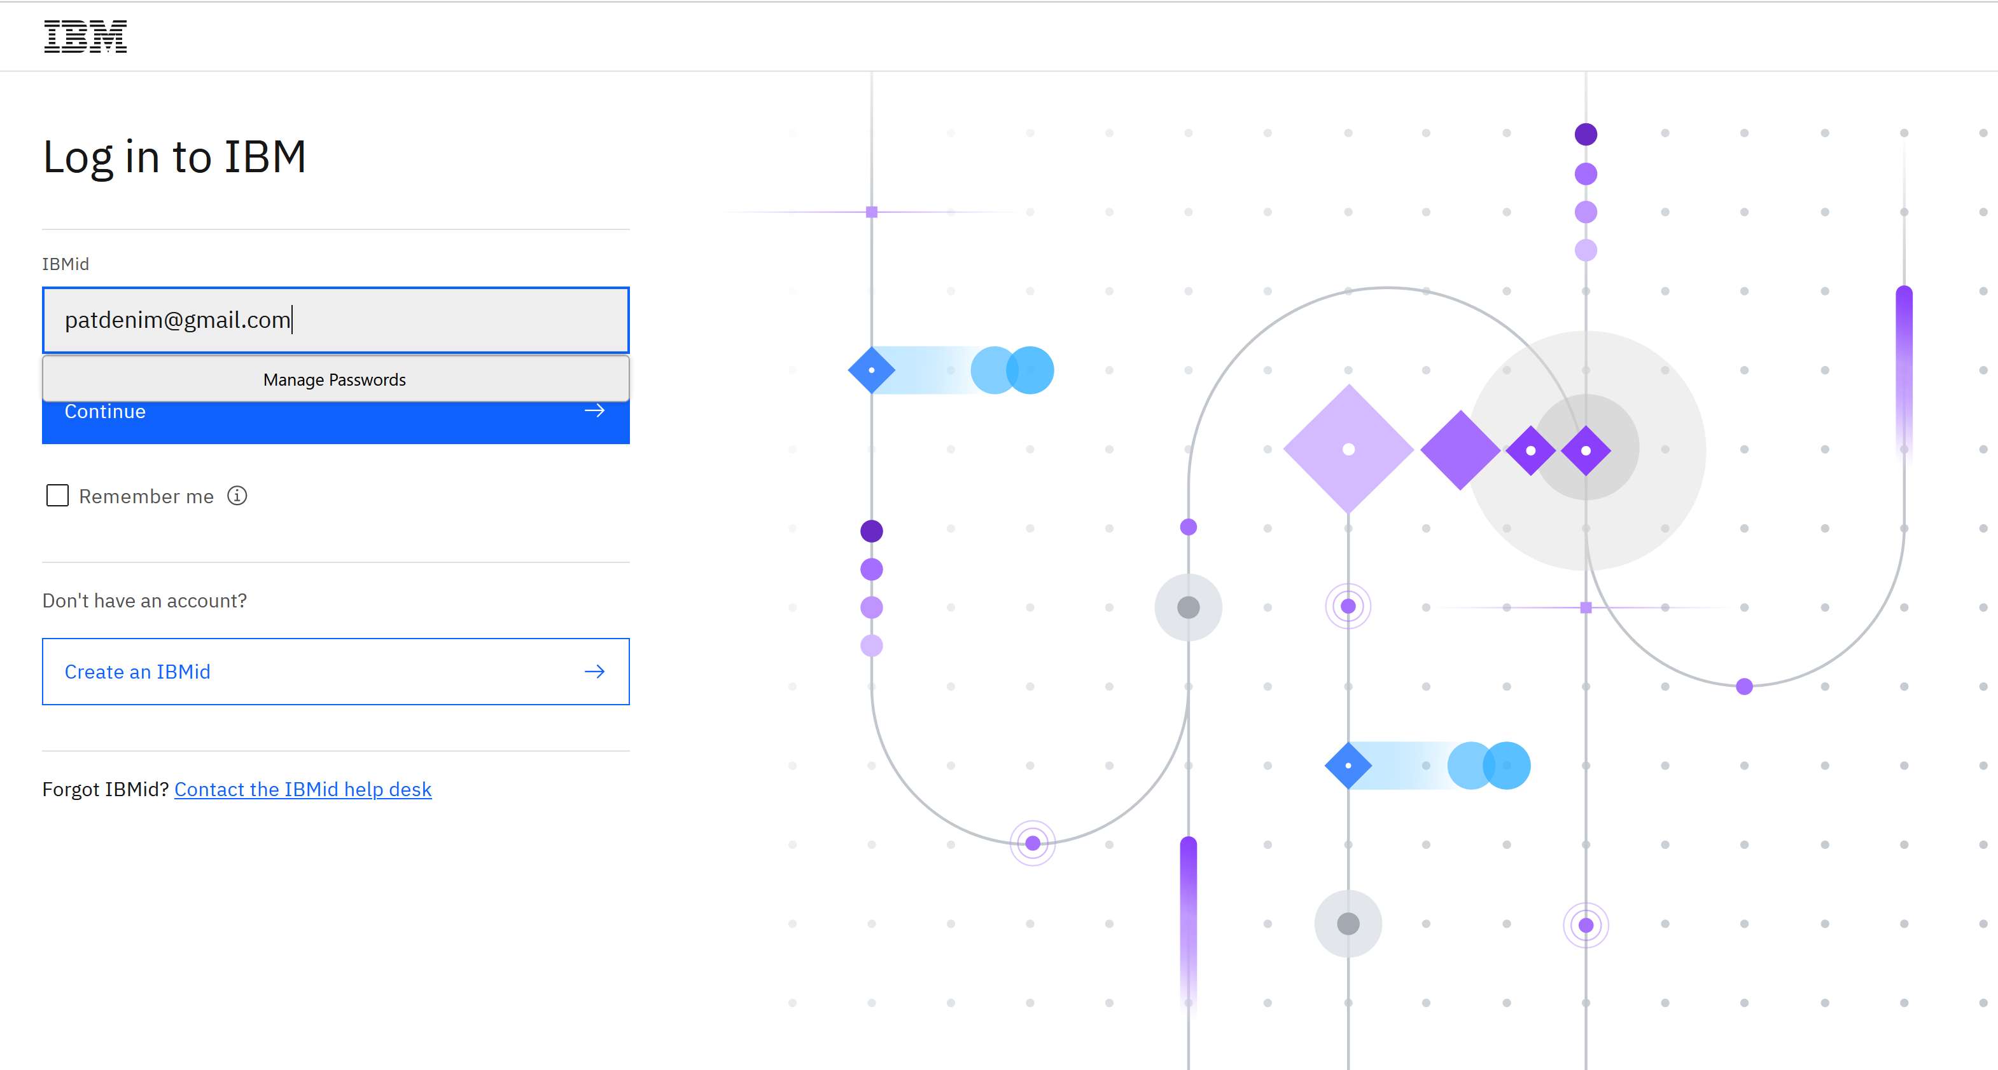
IBM Quantum Sign in
IBM Quantum

Slide 4
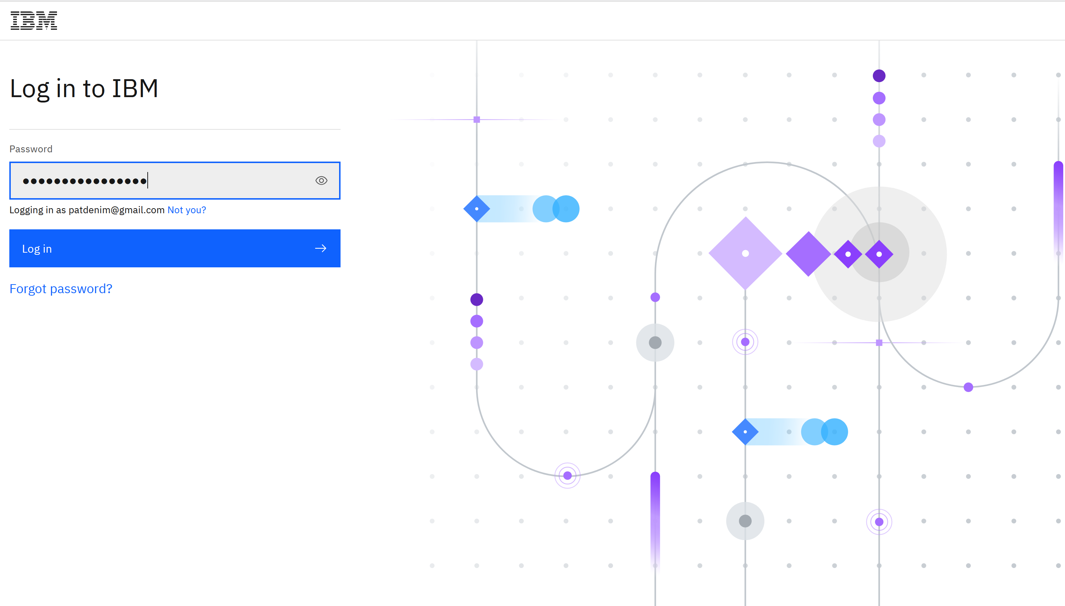
IBM Quantum Sign in
IBM Quantum

Slide 5
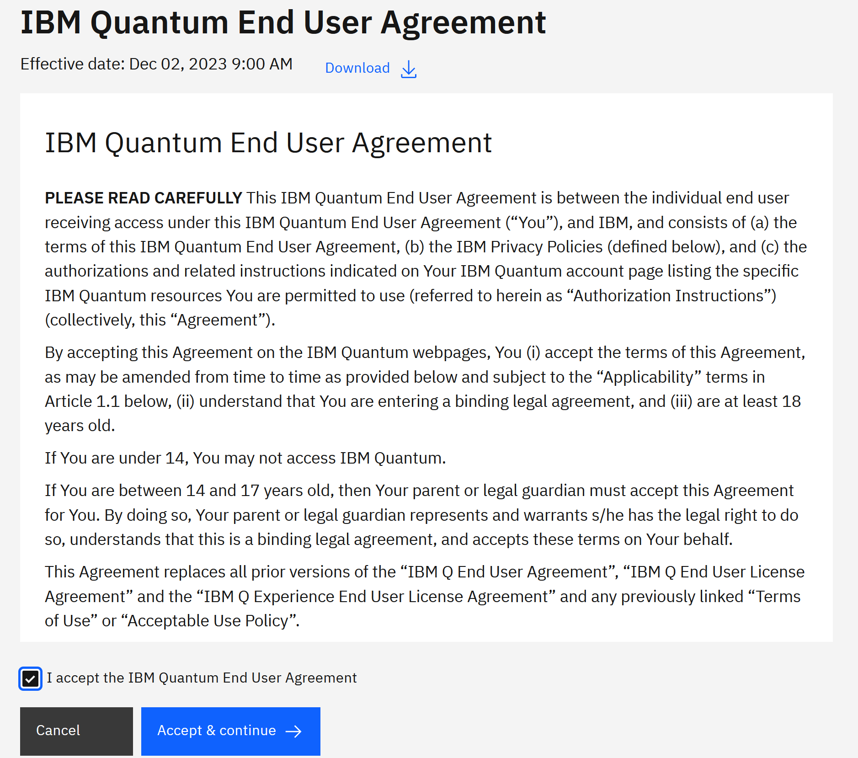
IBM Quantum Sign in
IBM Quantum

Slide 6
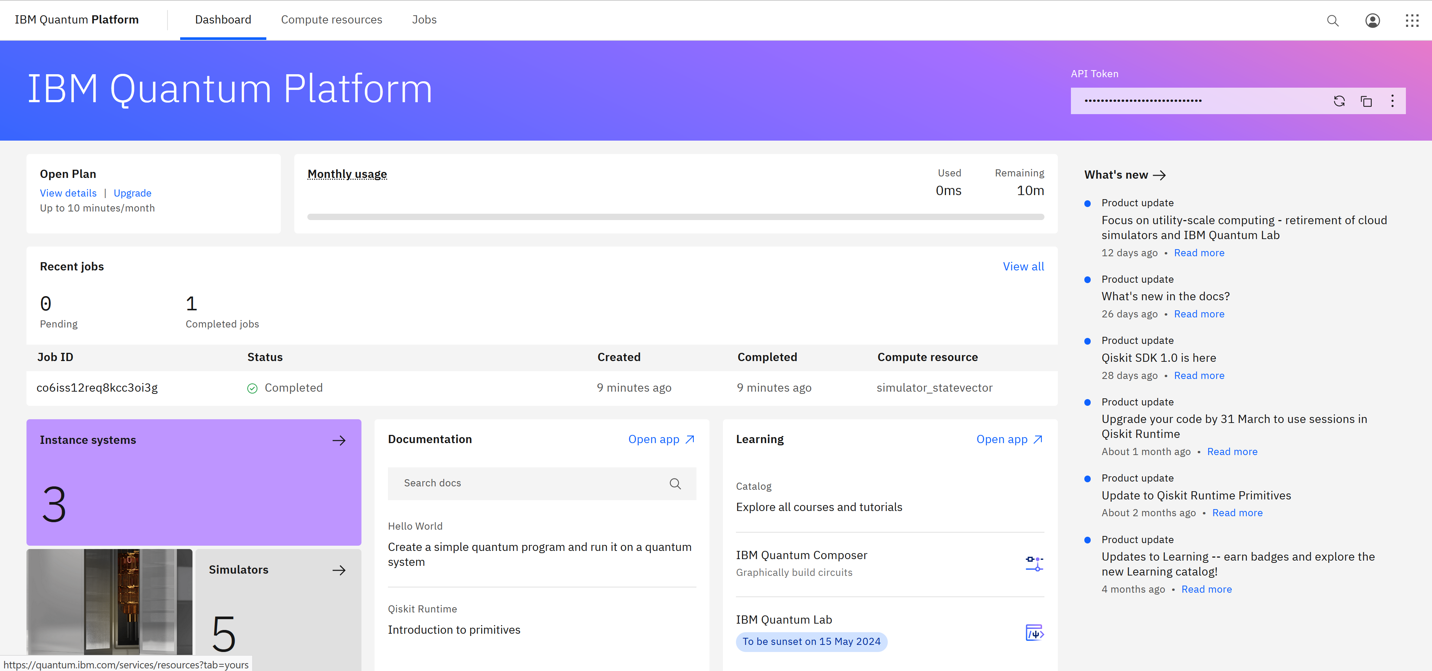
IBM Quantum Platform
IBM Quantum

Slide 7
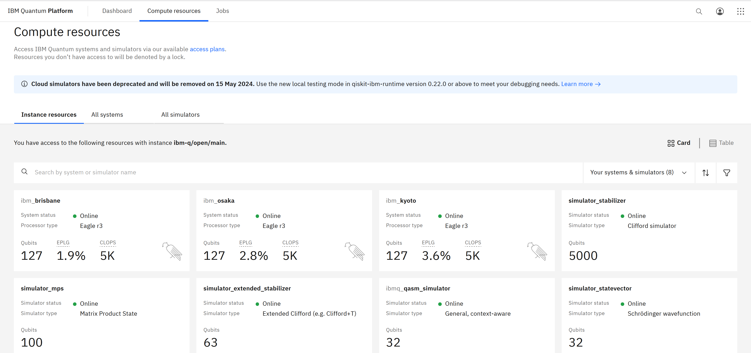
IBM Quantum Console
IBM Quantum

Slide 8
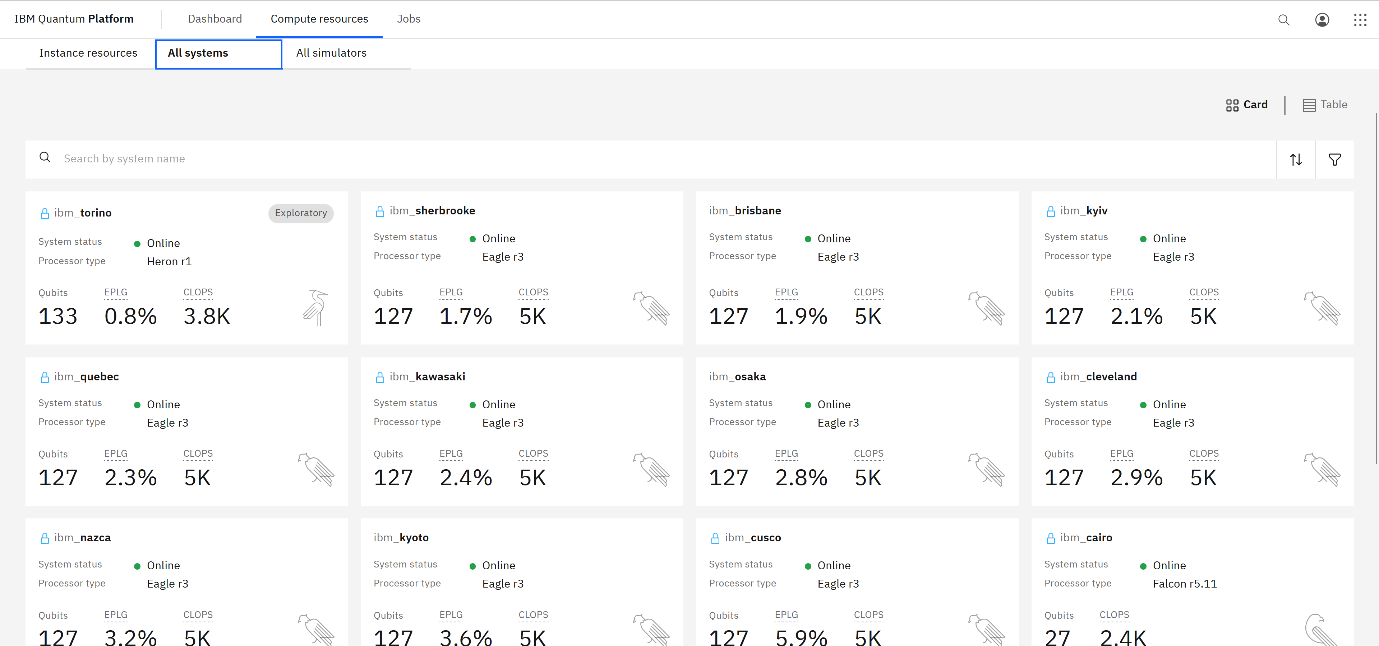
IBM Quantum Console
IBM Quantum

Slide 9
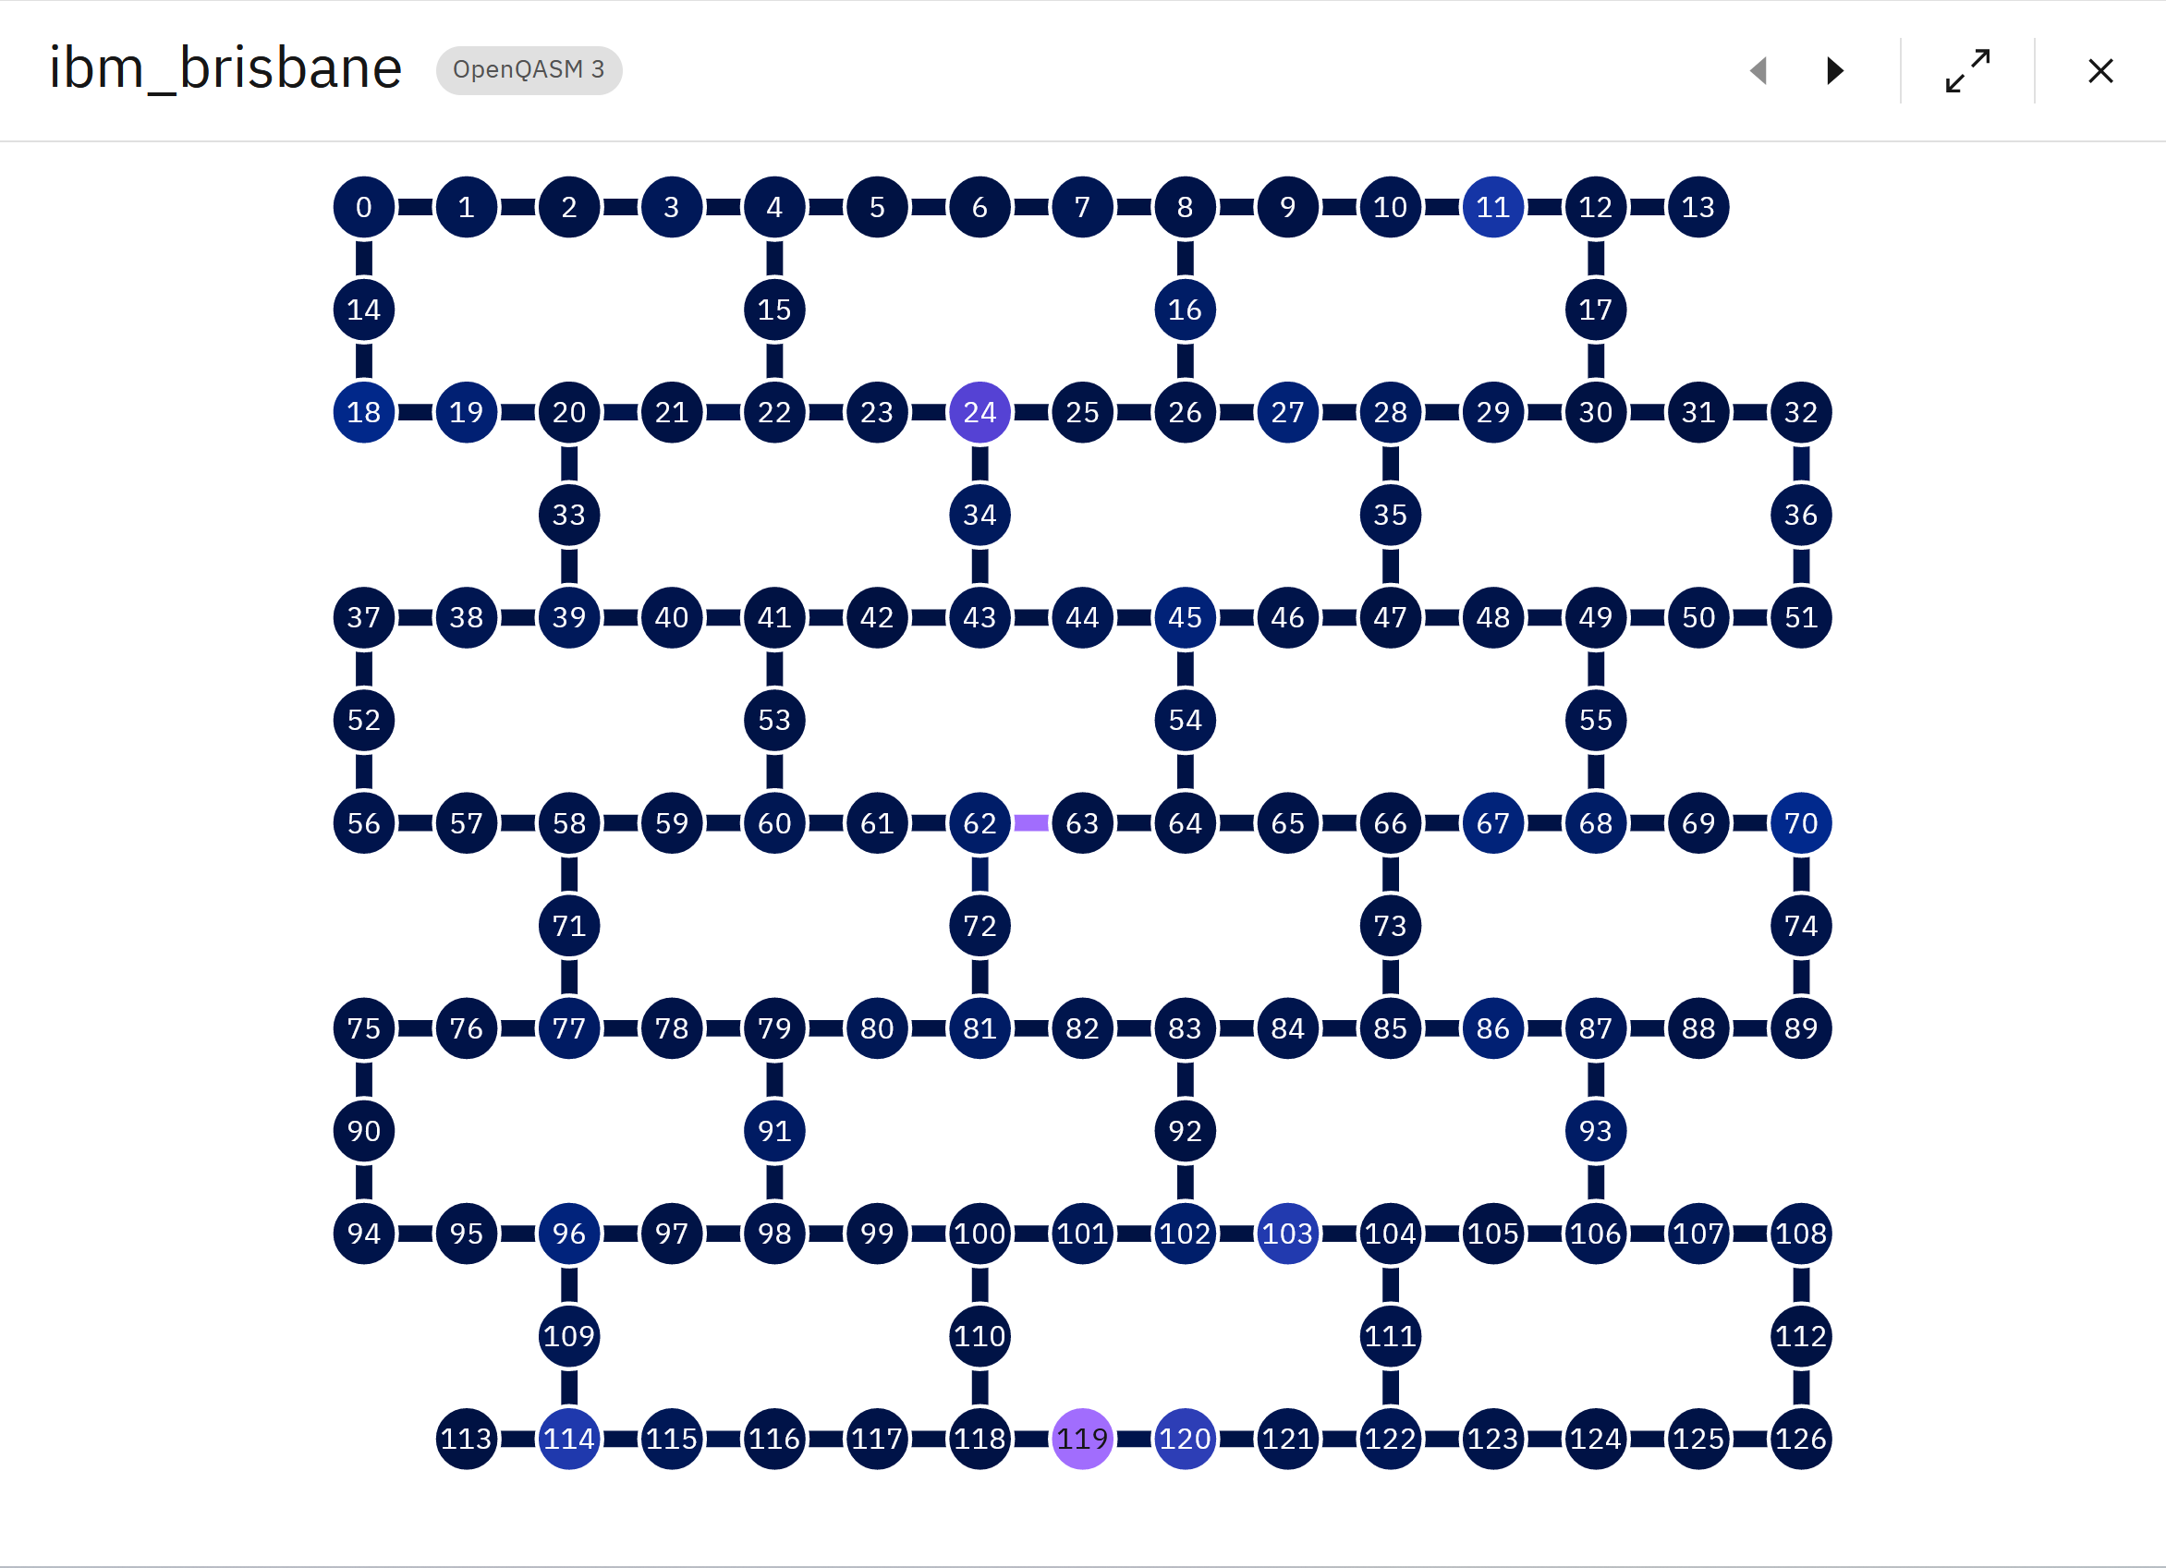
IBM Quantum Console
IBM Quantum

Slide 10
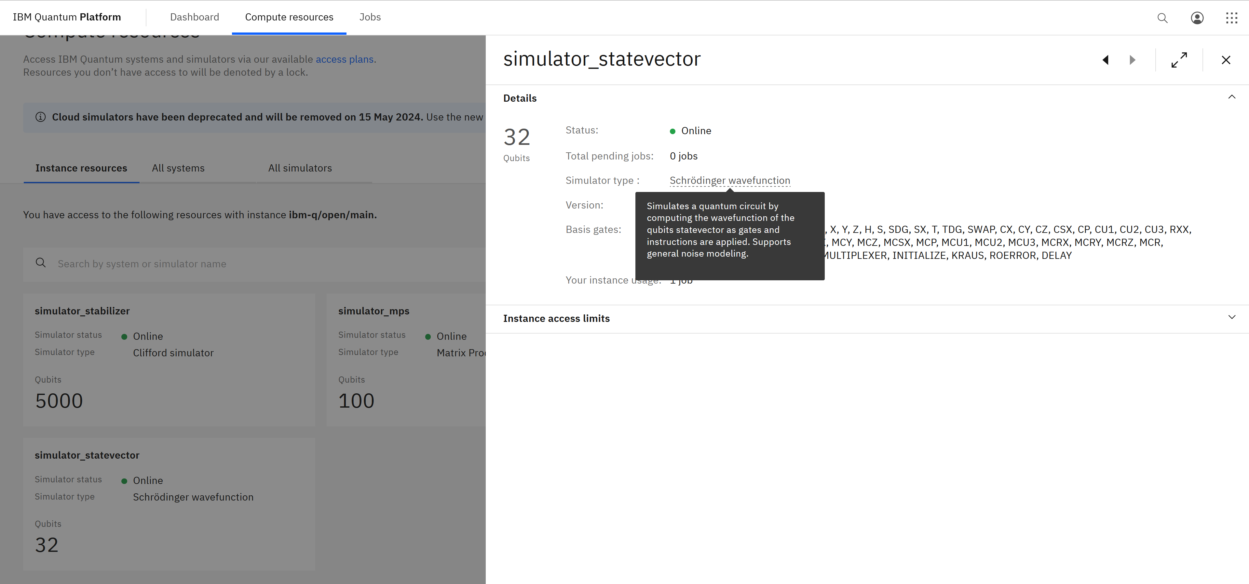
IBM Quantum Console
IBM Quantum

Slide 11
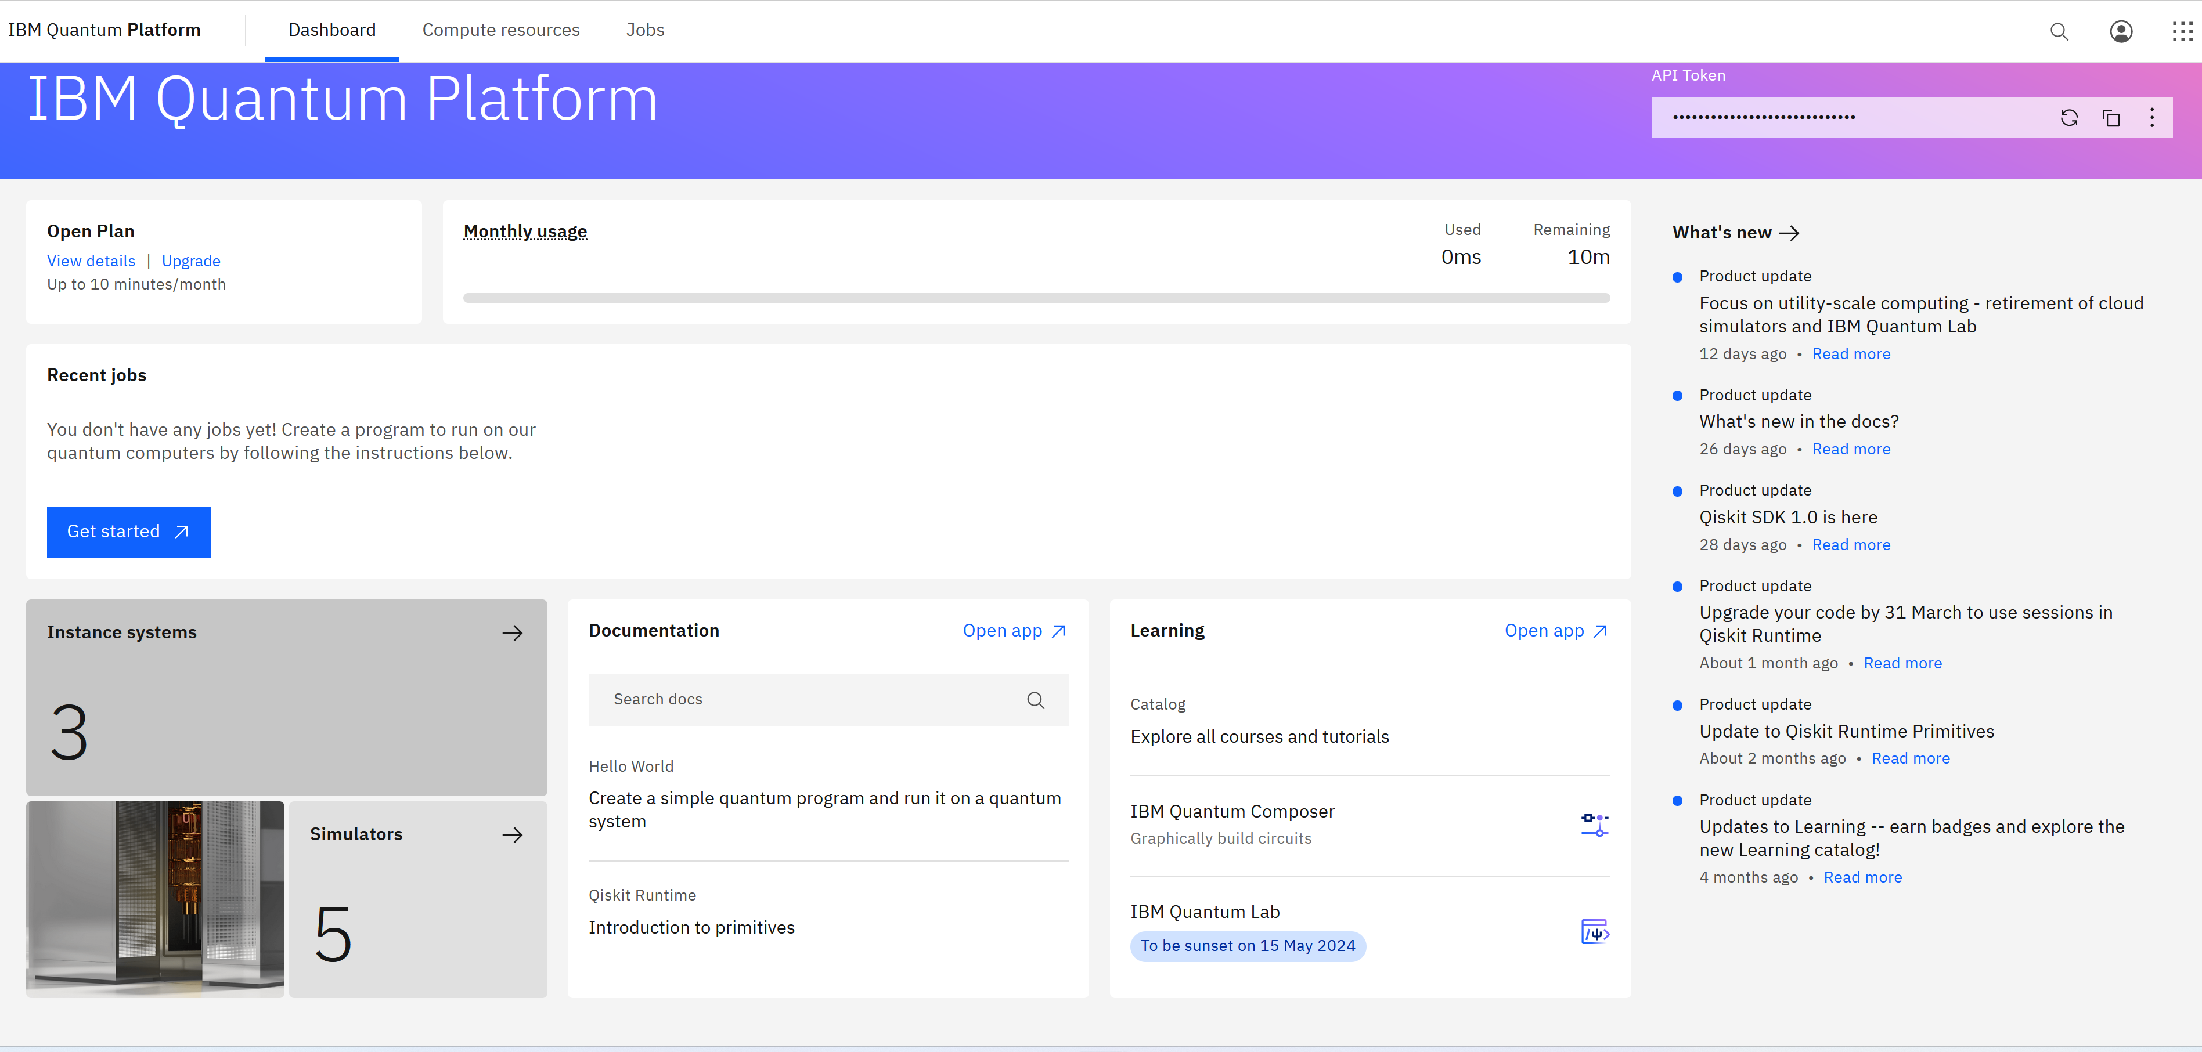
IBM Quantum Console
IBM Quantum

Slide 12
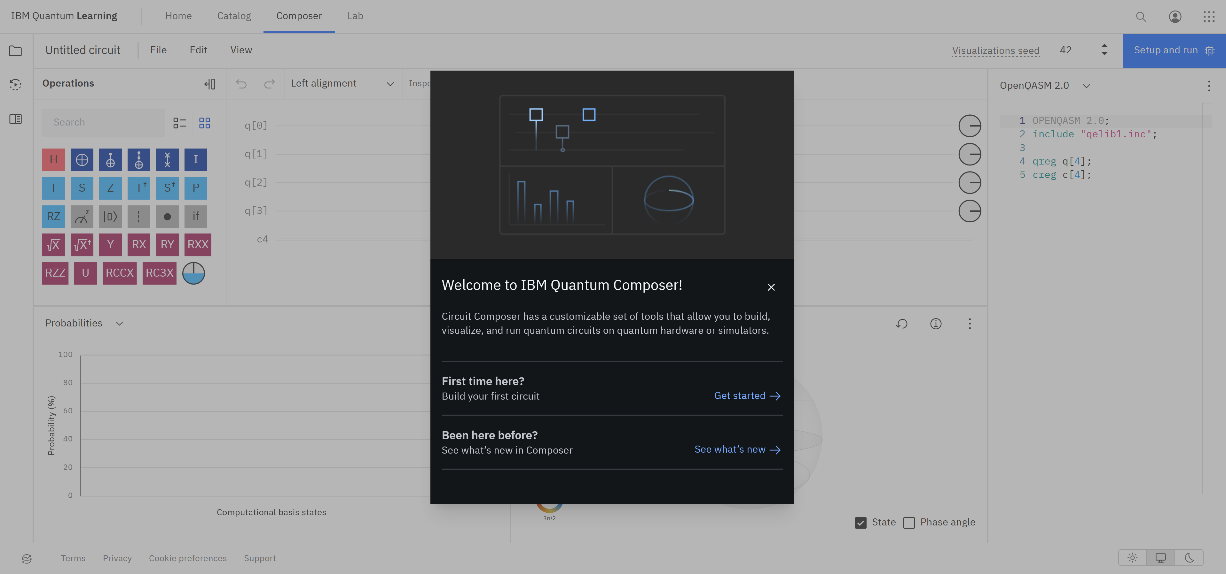
IBM Quantum Console
IBM Quantum

Slide 13
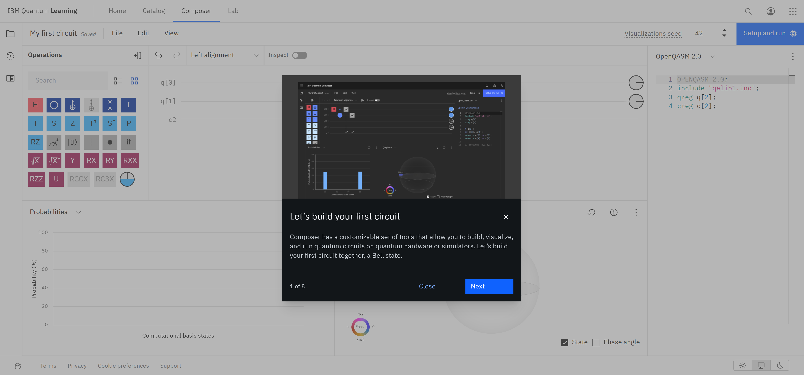
IBM Quantum Console
IBM Quantum

Slide 14
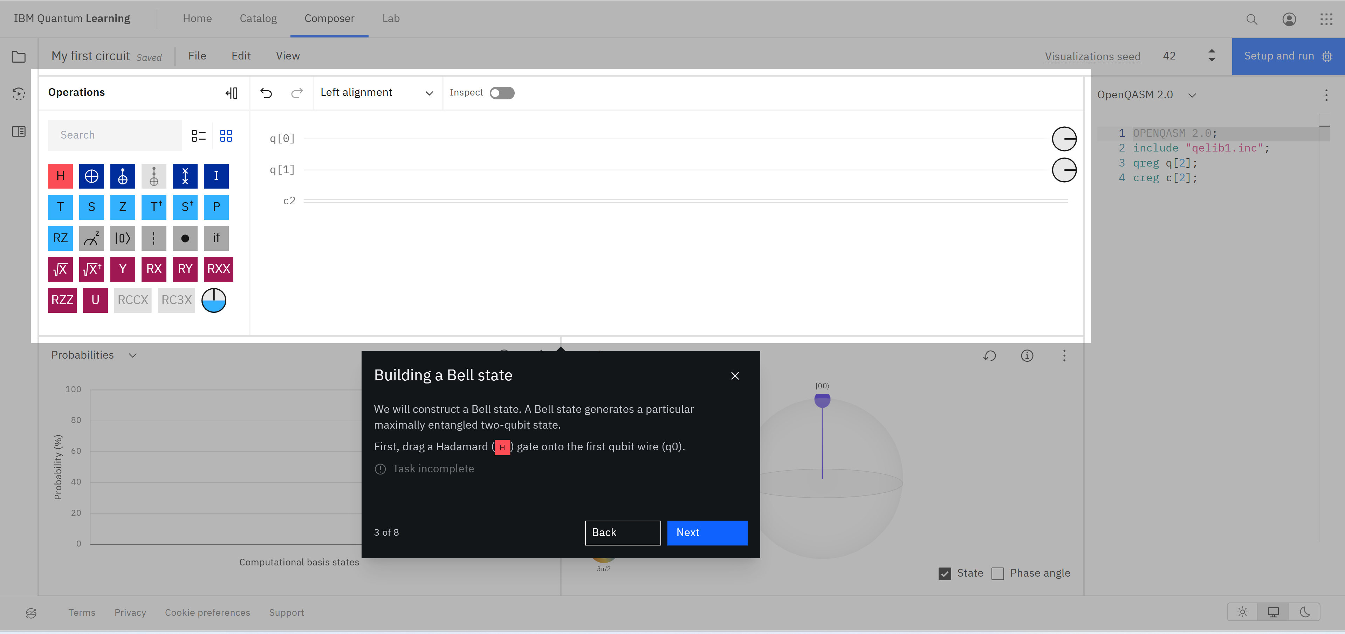
IBM Quantum Console
IBM Quantum

Slide 15
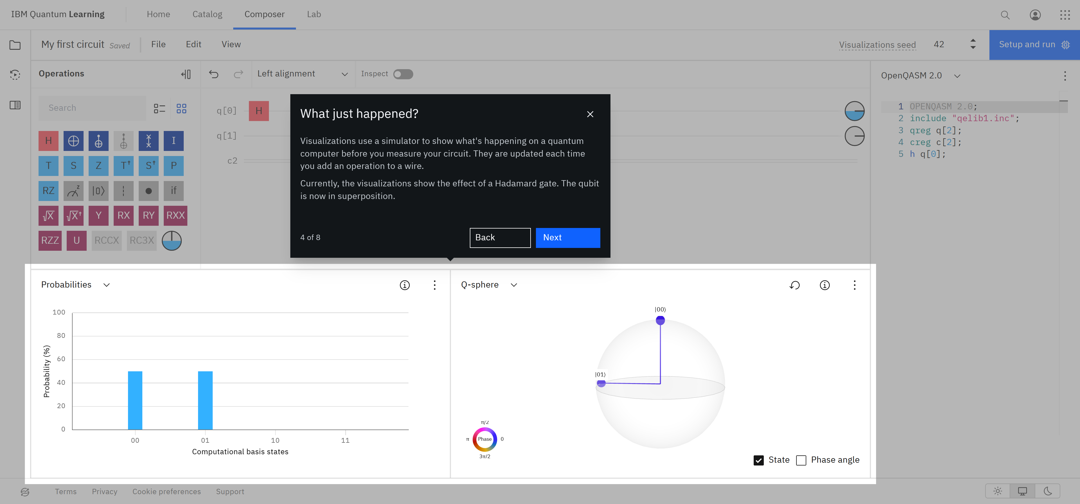
IBM Quantum Console
IBM Quantum

Slide 16
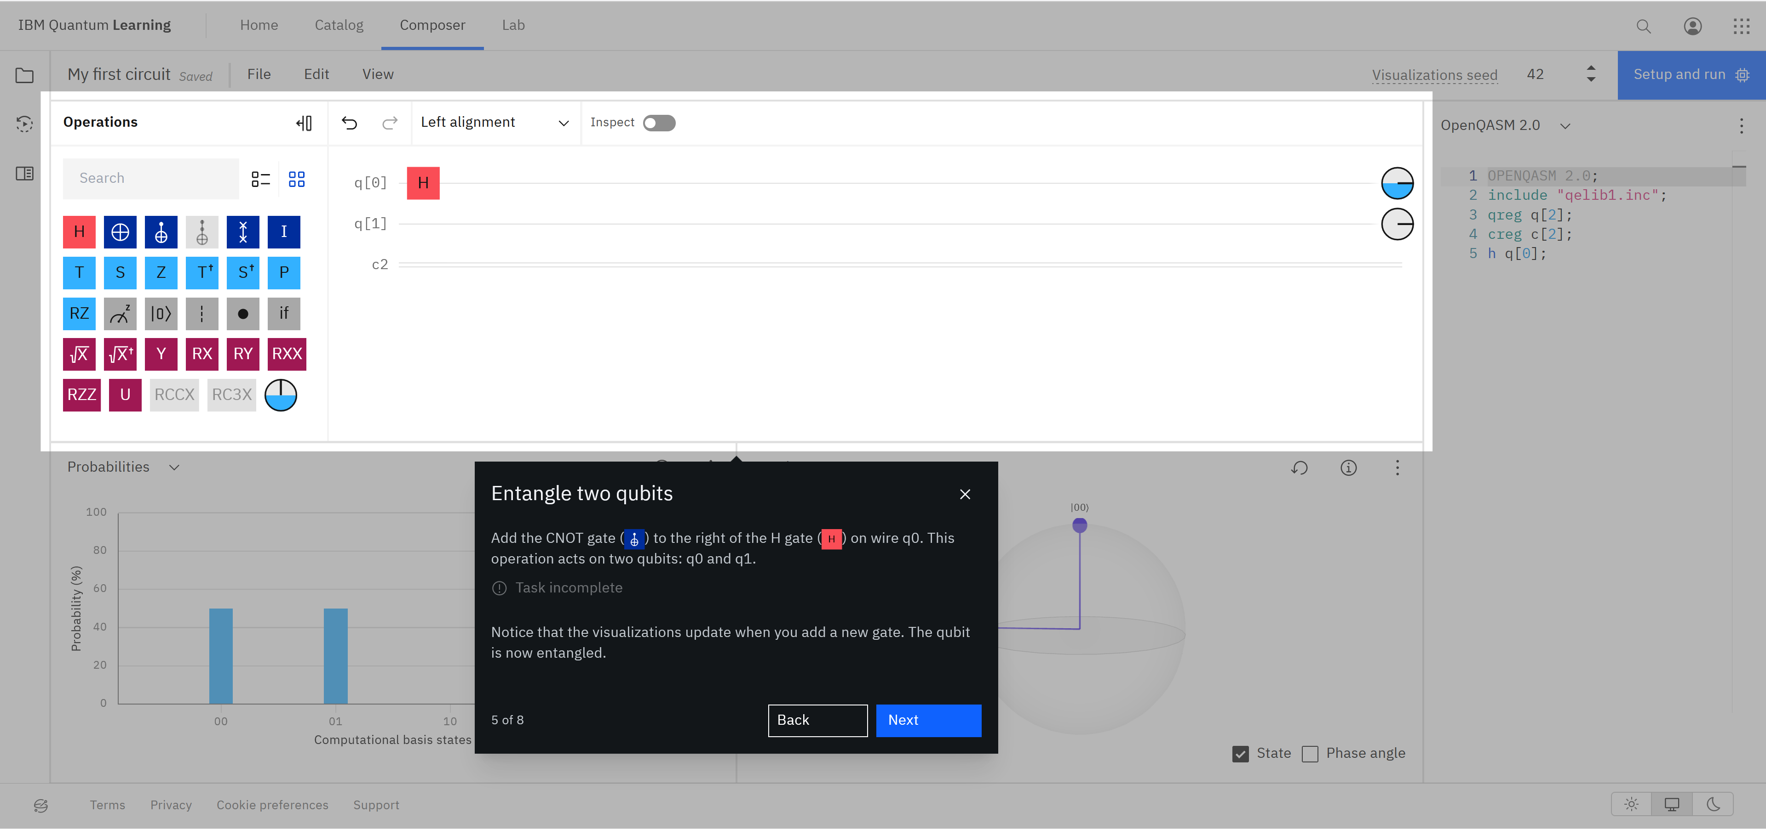
IBM Quantum Console
IBM Quantum

Slide 17
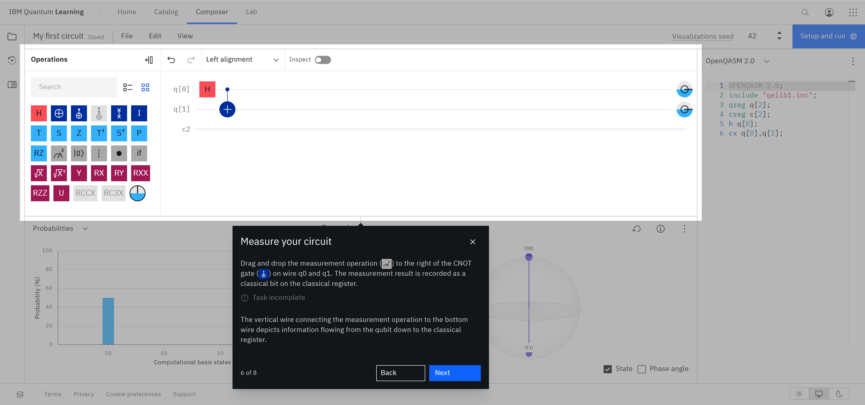
IBM Quantum Console
IBM Quantum

Slide 18
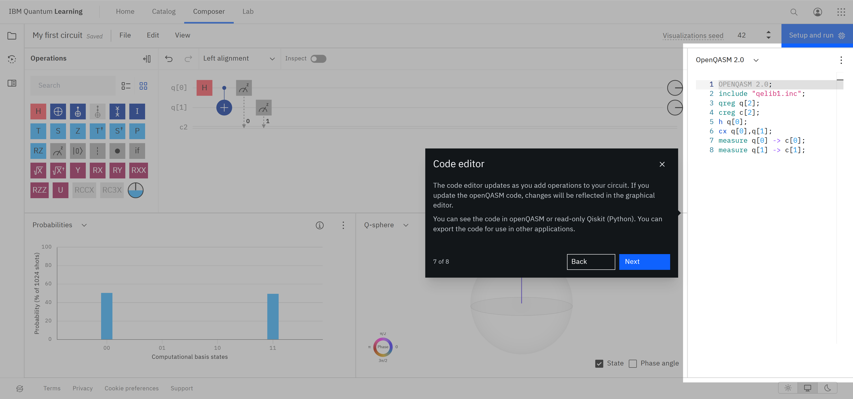
IBM Quantum Console
IBM Quantum

Slide 19
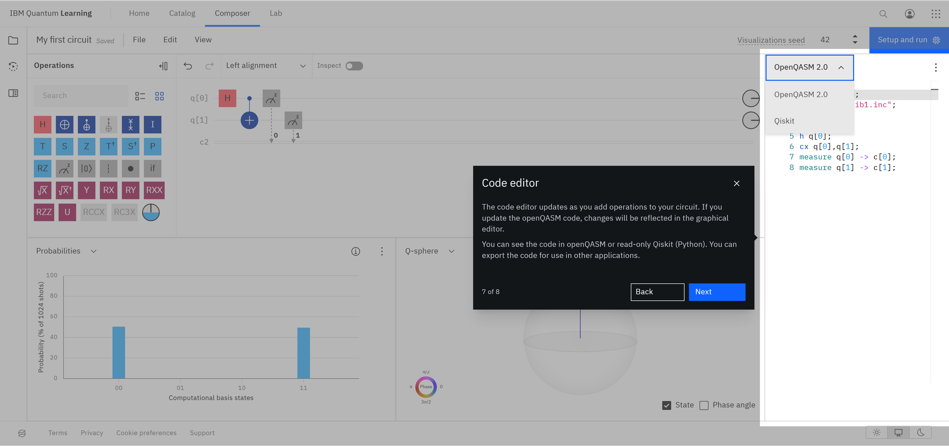
IBM Quantum Console
IBM Quantum

Slide 20
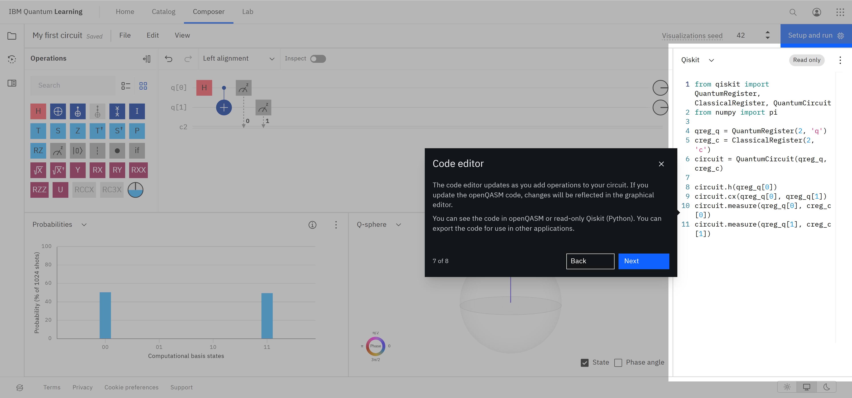
IBM Quantum Console
IBM Quantum

Slide 21
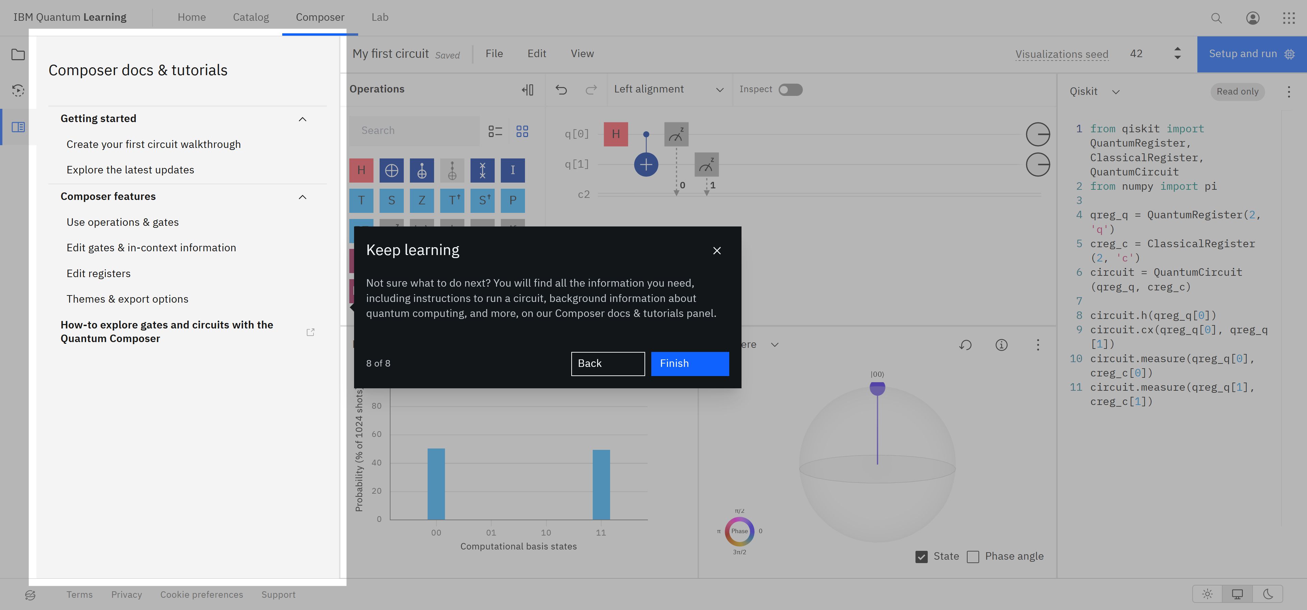
IBM Quantum Console
IBM Quantum

Slide 22
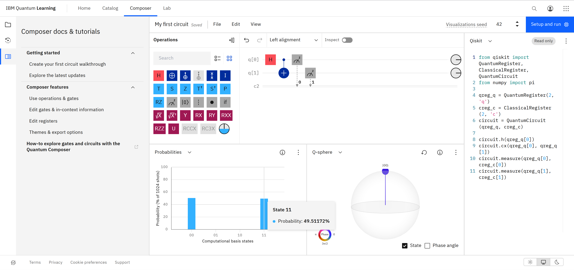
IBM Quantum Console
IBM Quantum

Slide 23
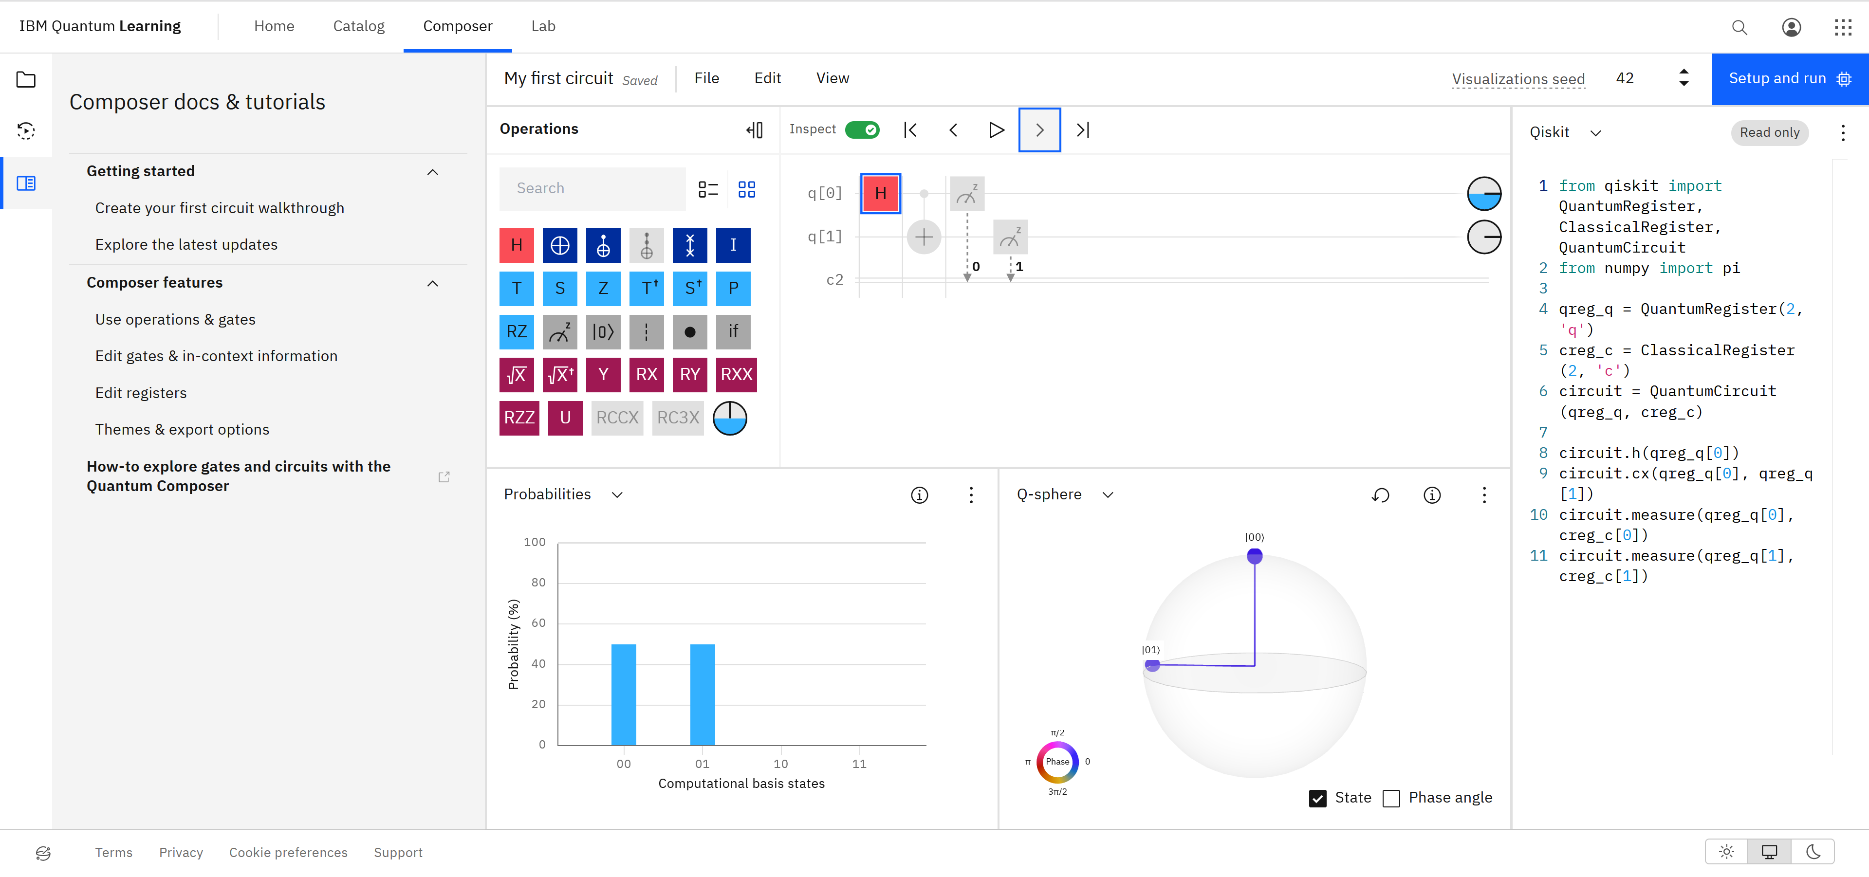
IBM Quantum Console
IBM Quantum

Slide 24
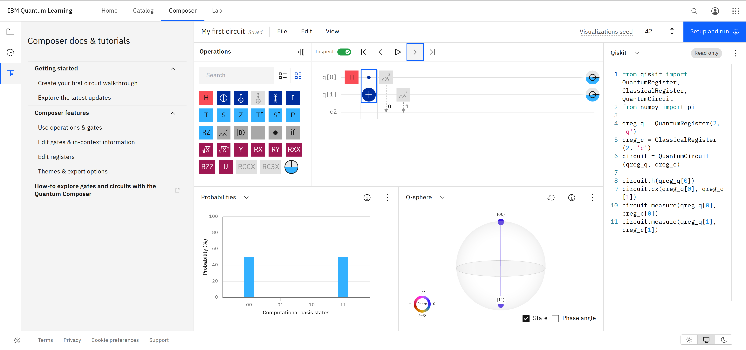
IBM Quantum Console
IBM Quantum

Slide 25

IBM Quantum Console
IBM Quantum

Slide 26
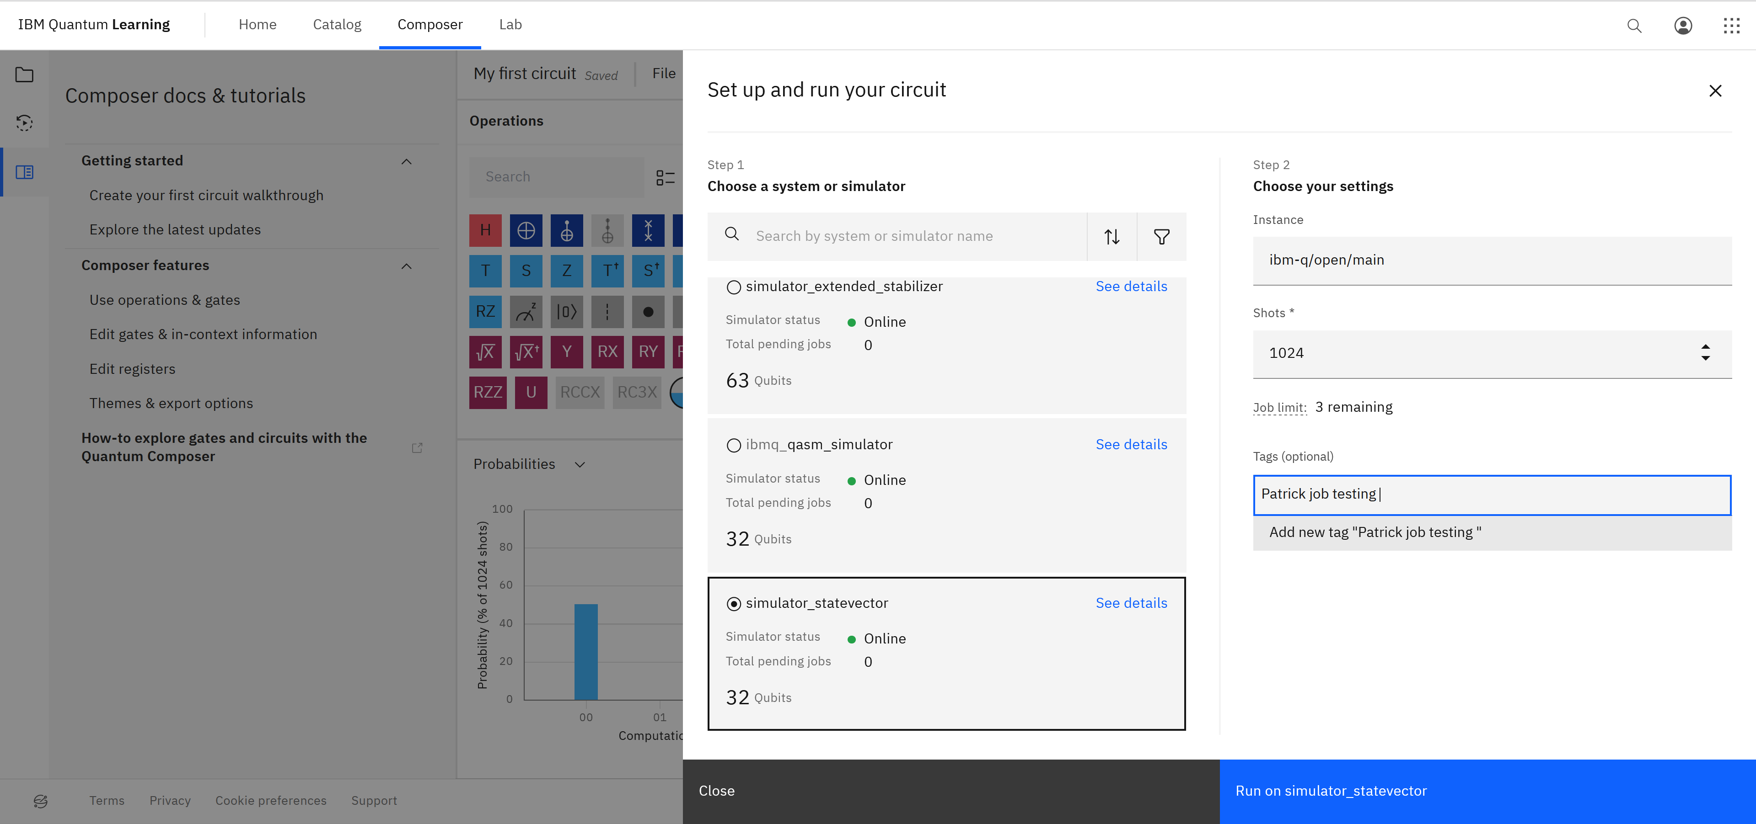
IBM Quantum Console
IBM Quantum

Slide 27
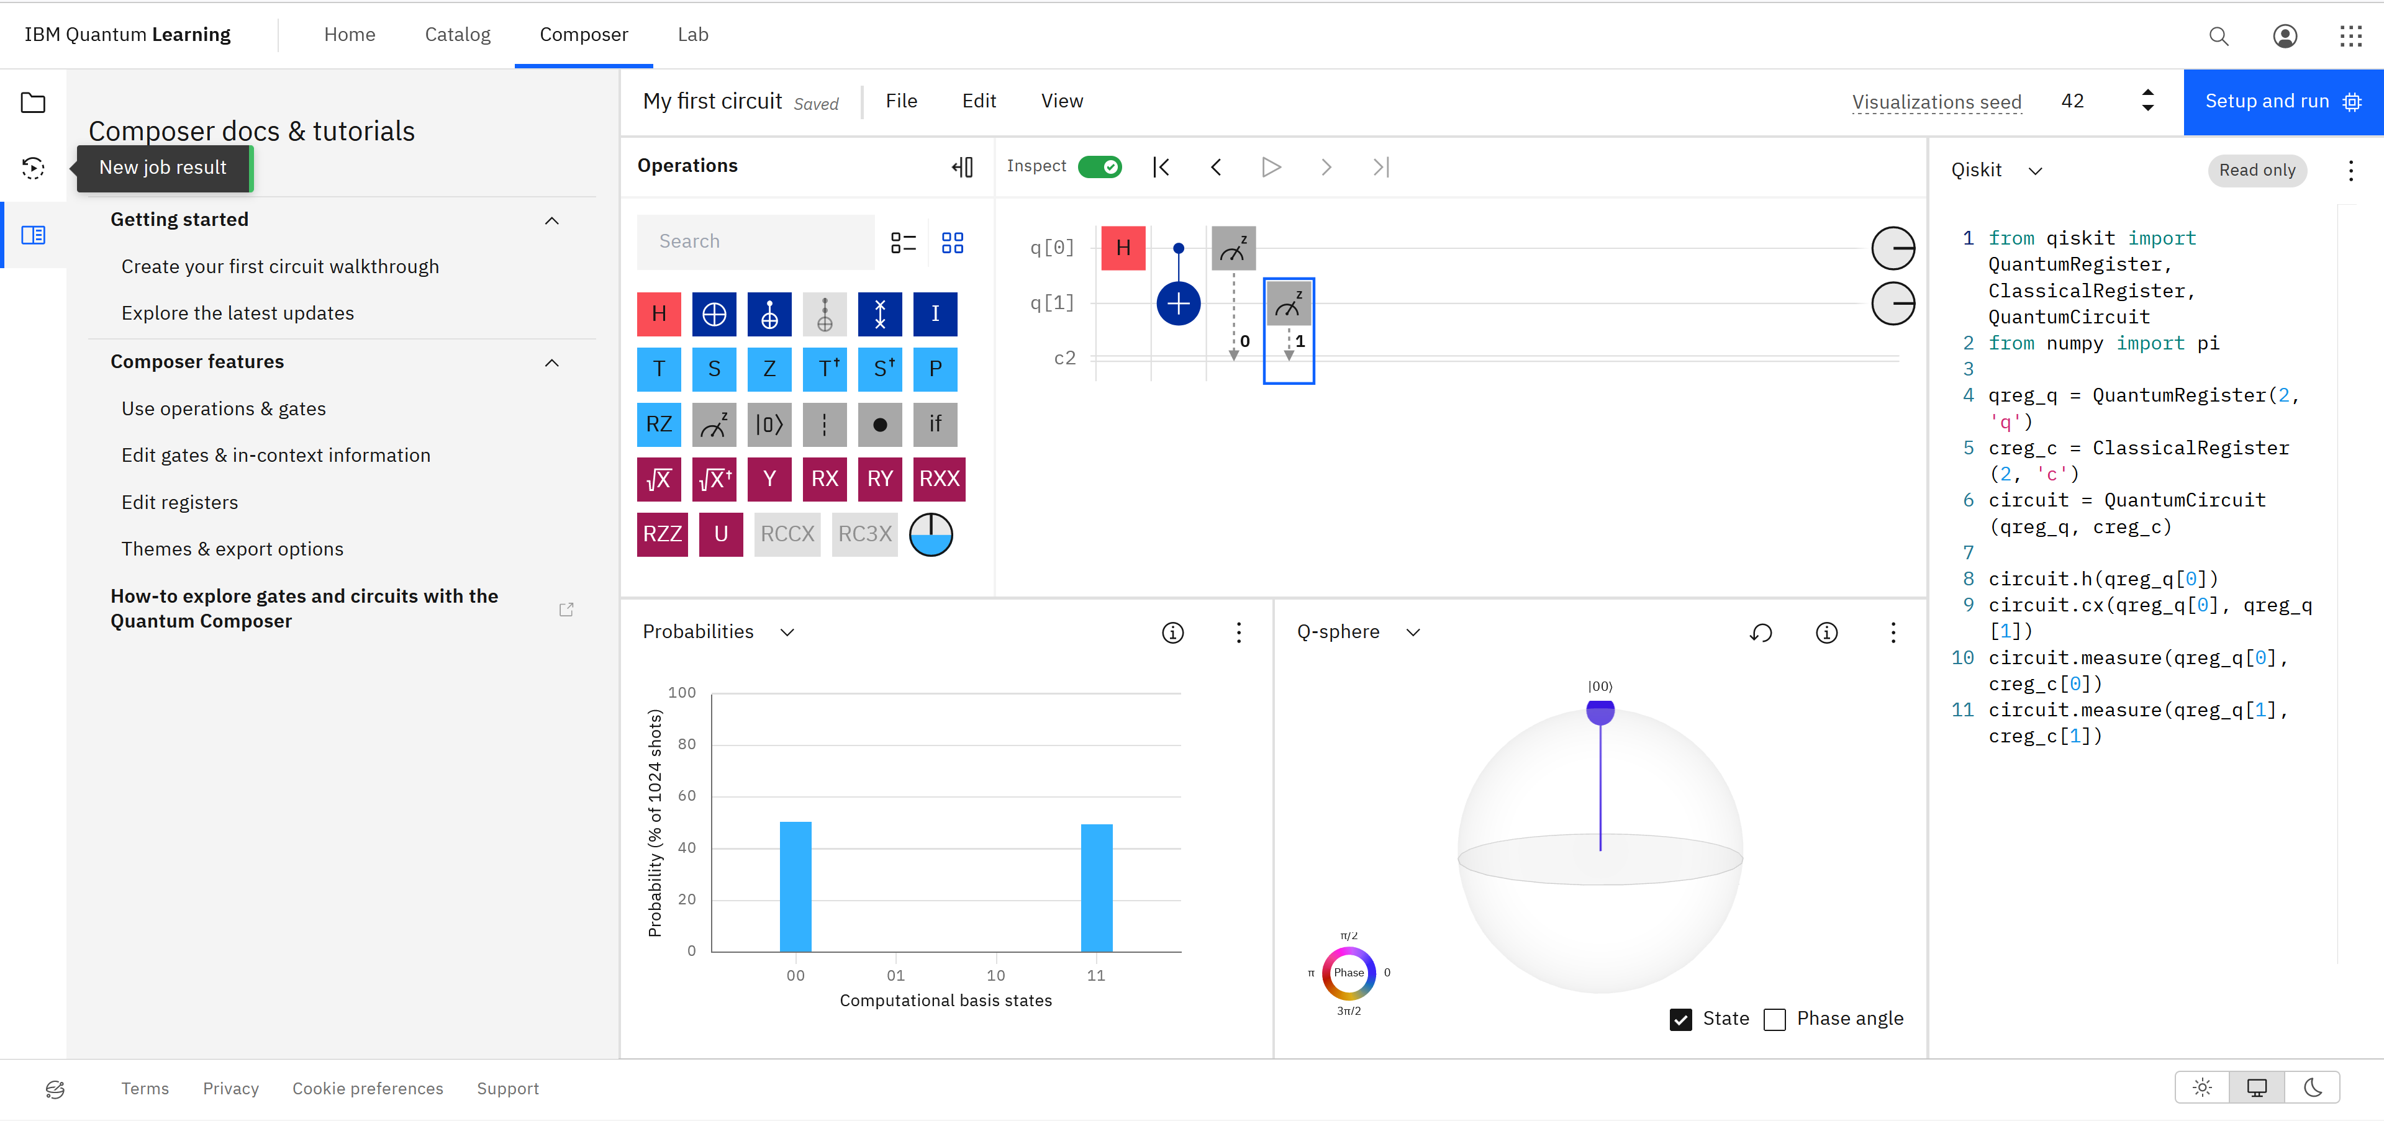
IBM Quantum Console
IBM Quantum

Slide 28
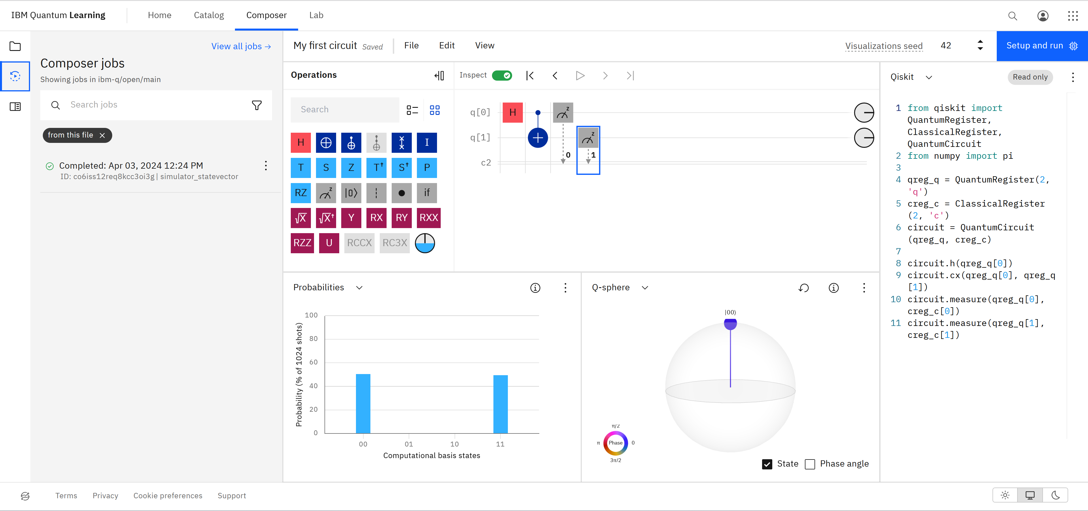
IBM Quantum Console
IBM Quantum

Slide 29
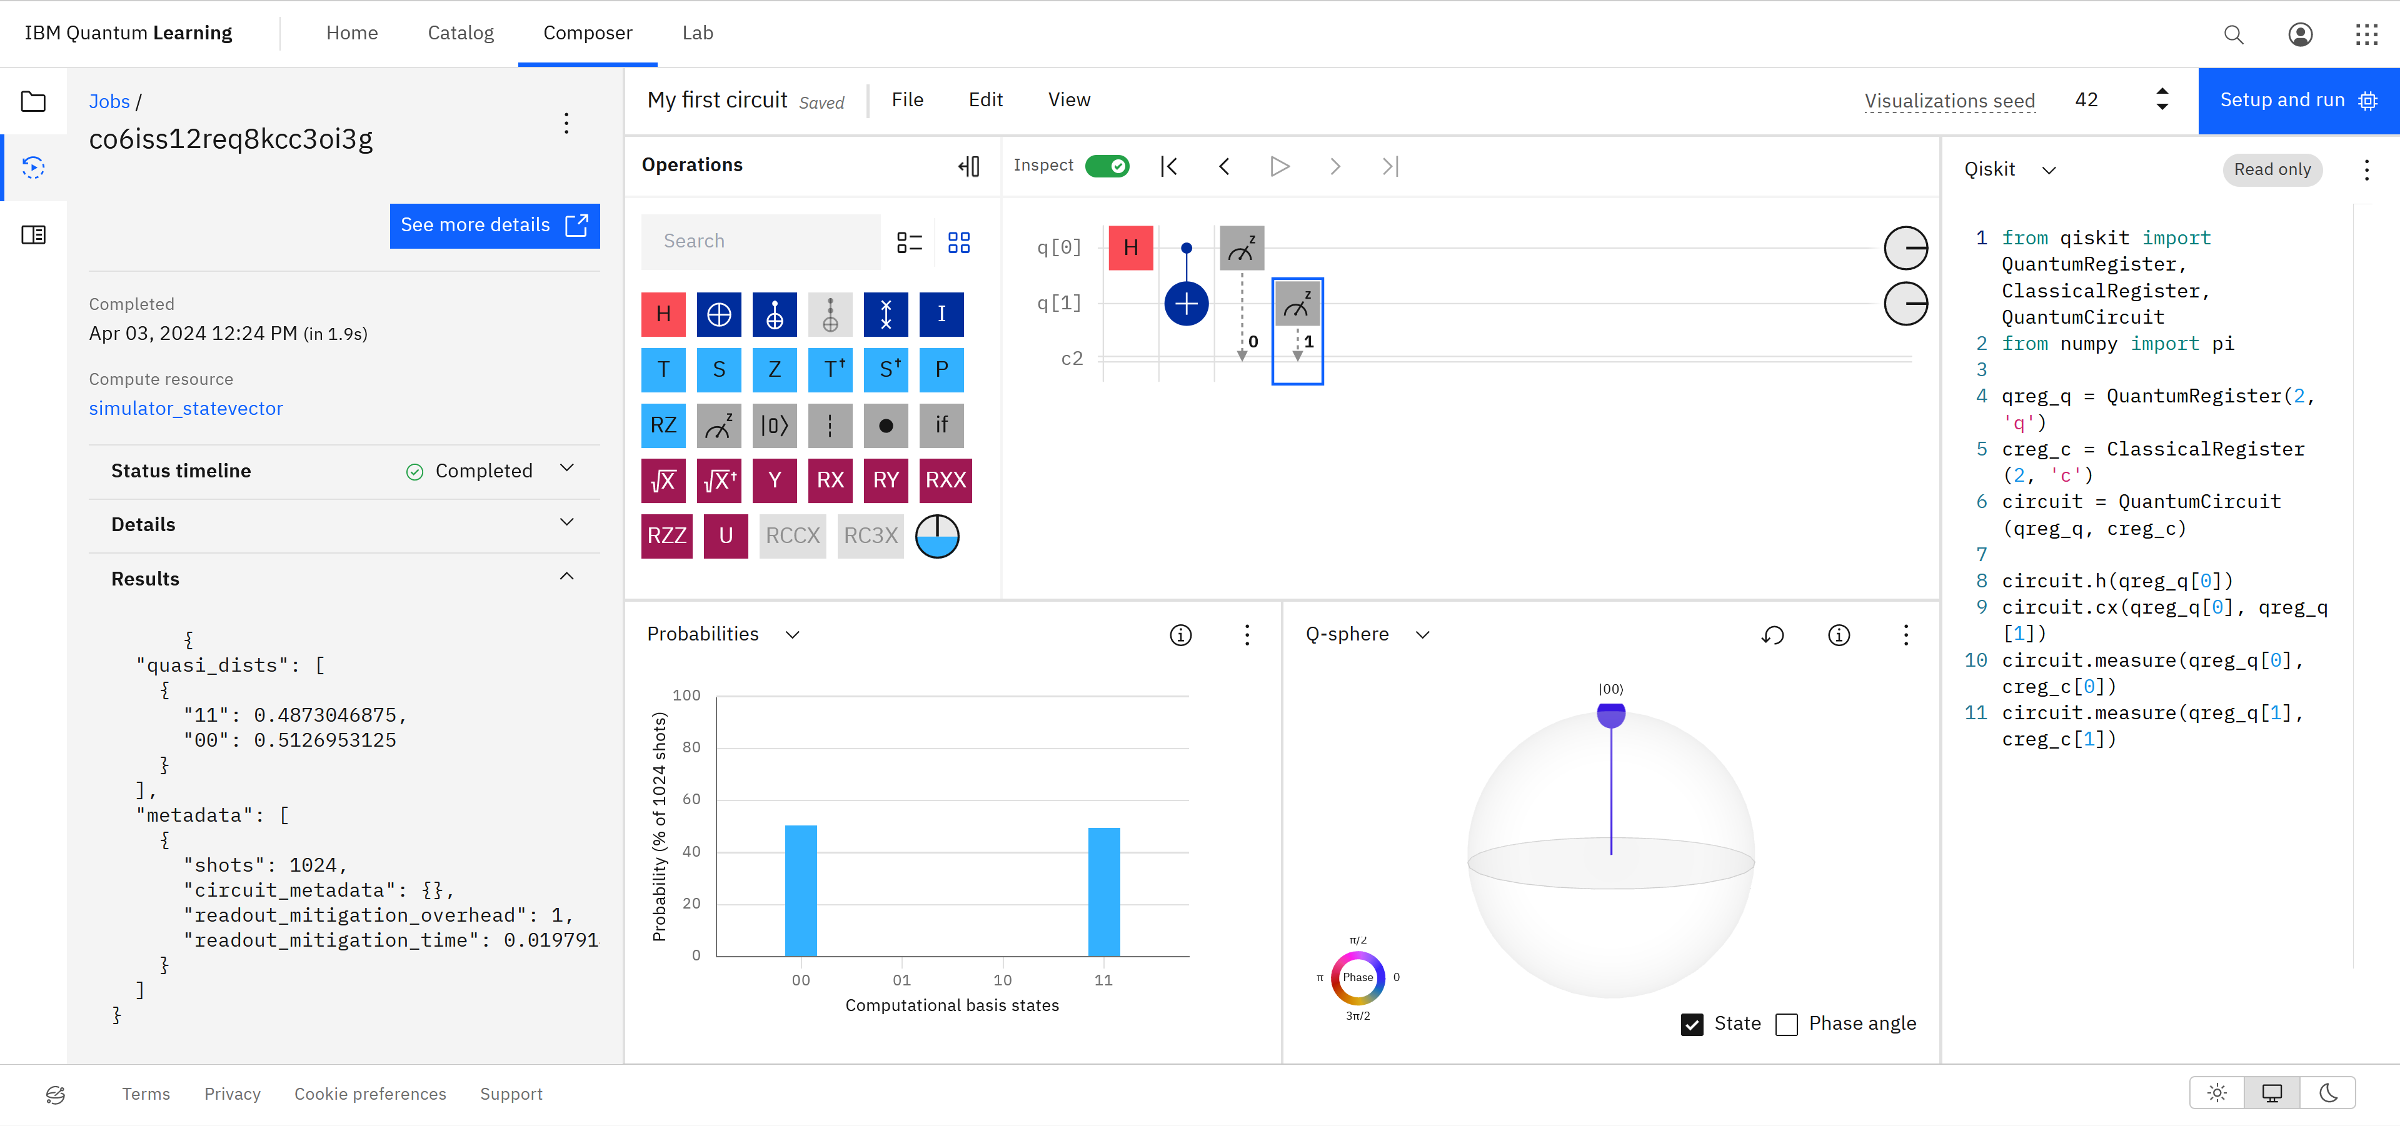
IBM Quantum Console
IBM Quantum

Slide 30
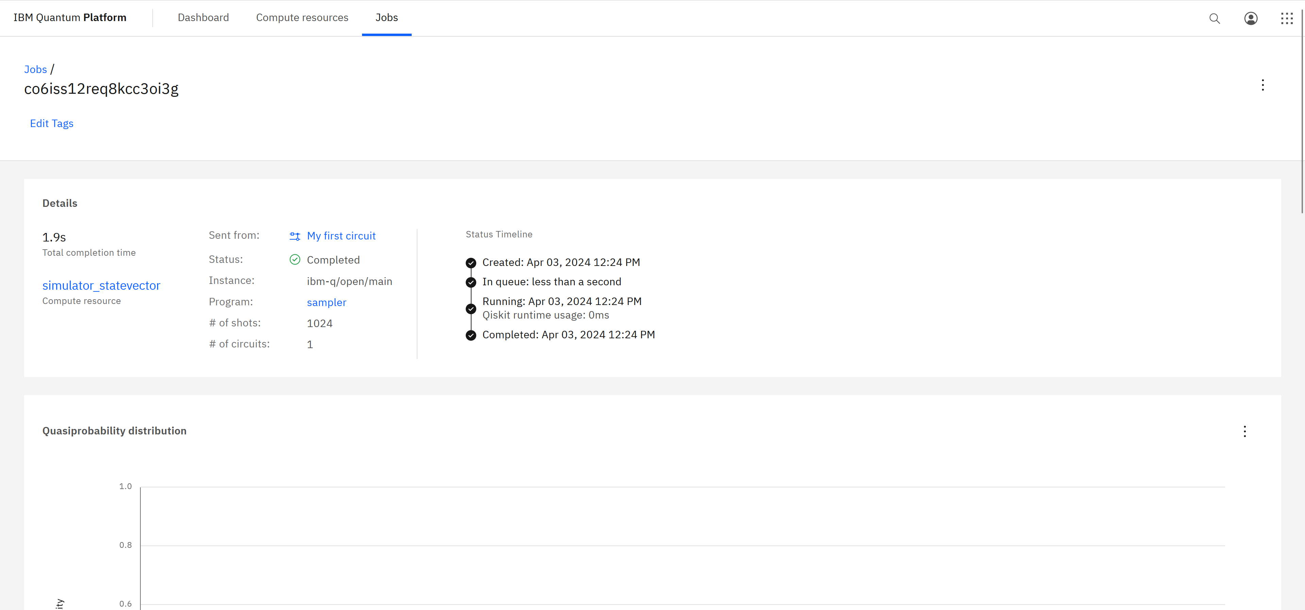
IBM Quantum Console
IBM Quantum

Slide 31
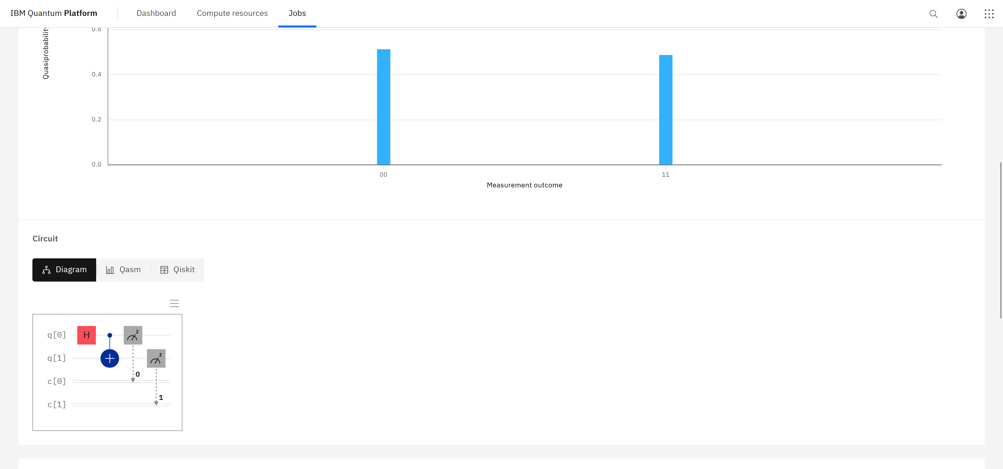
IBM Quantum Console
IBM Quantum

Slide 32
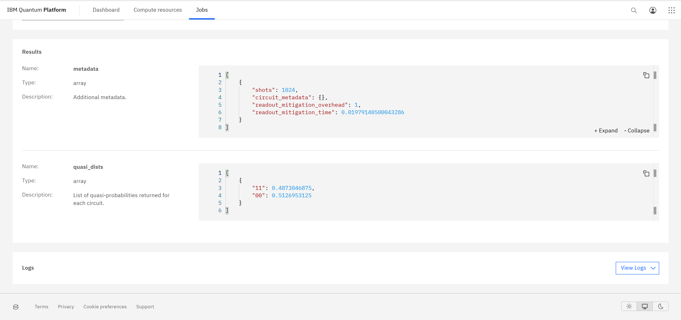
IBM Quantum Console
IBM Quantum

Slide 33
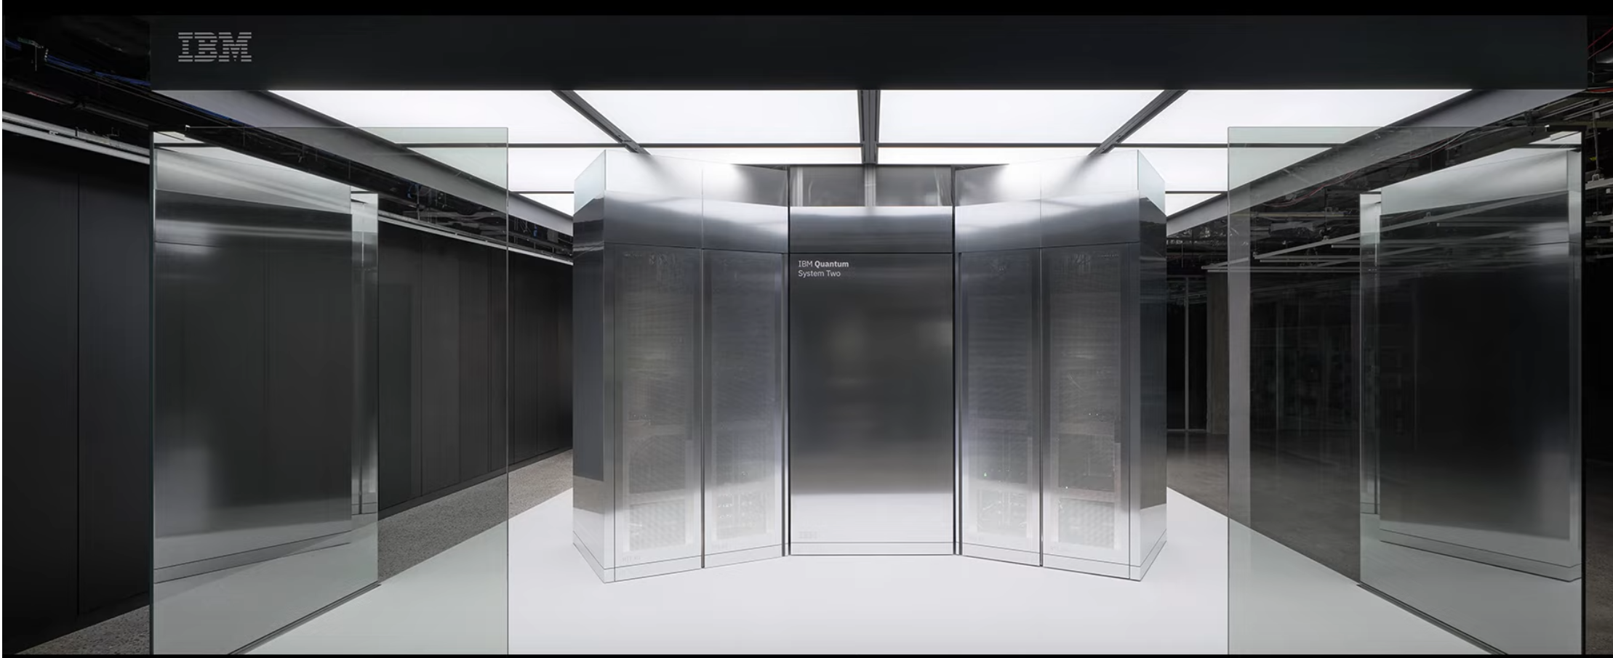
IBM Quantum Lab
IBM Quantum

Slide 34
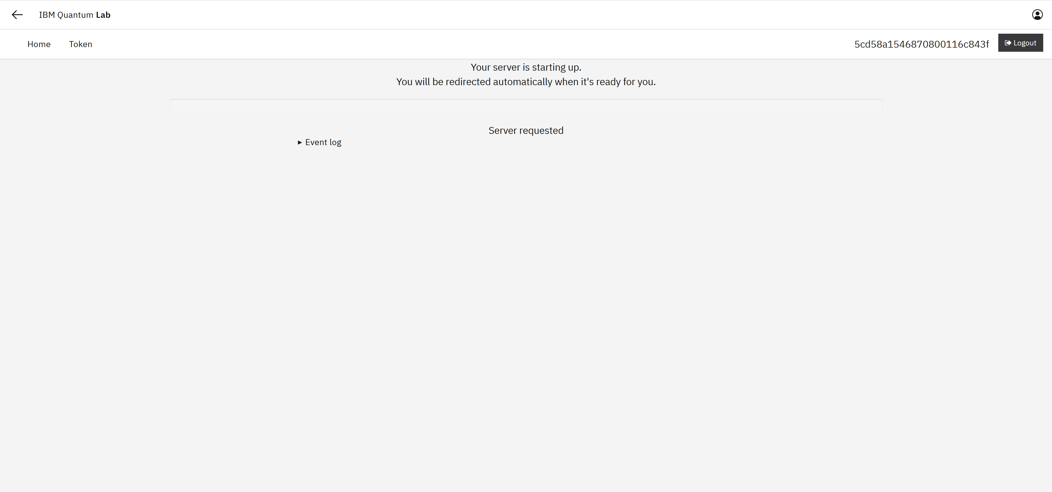
IBM Quantum Lab
IBM Quantum

Slide 35
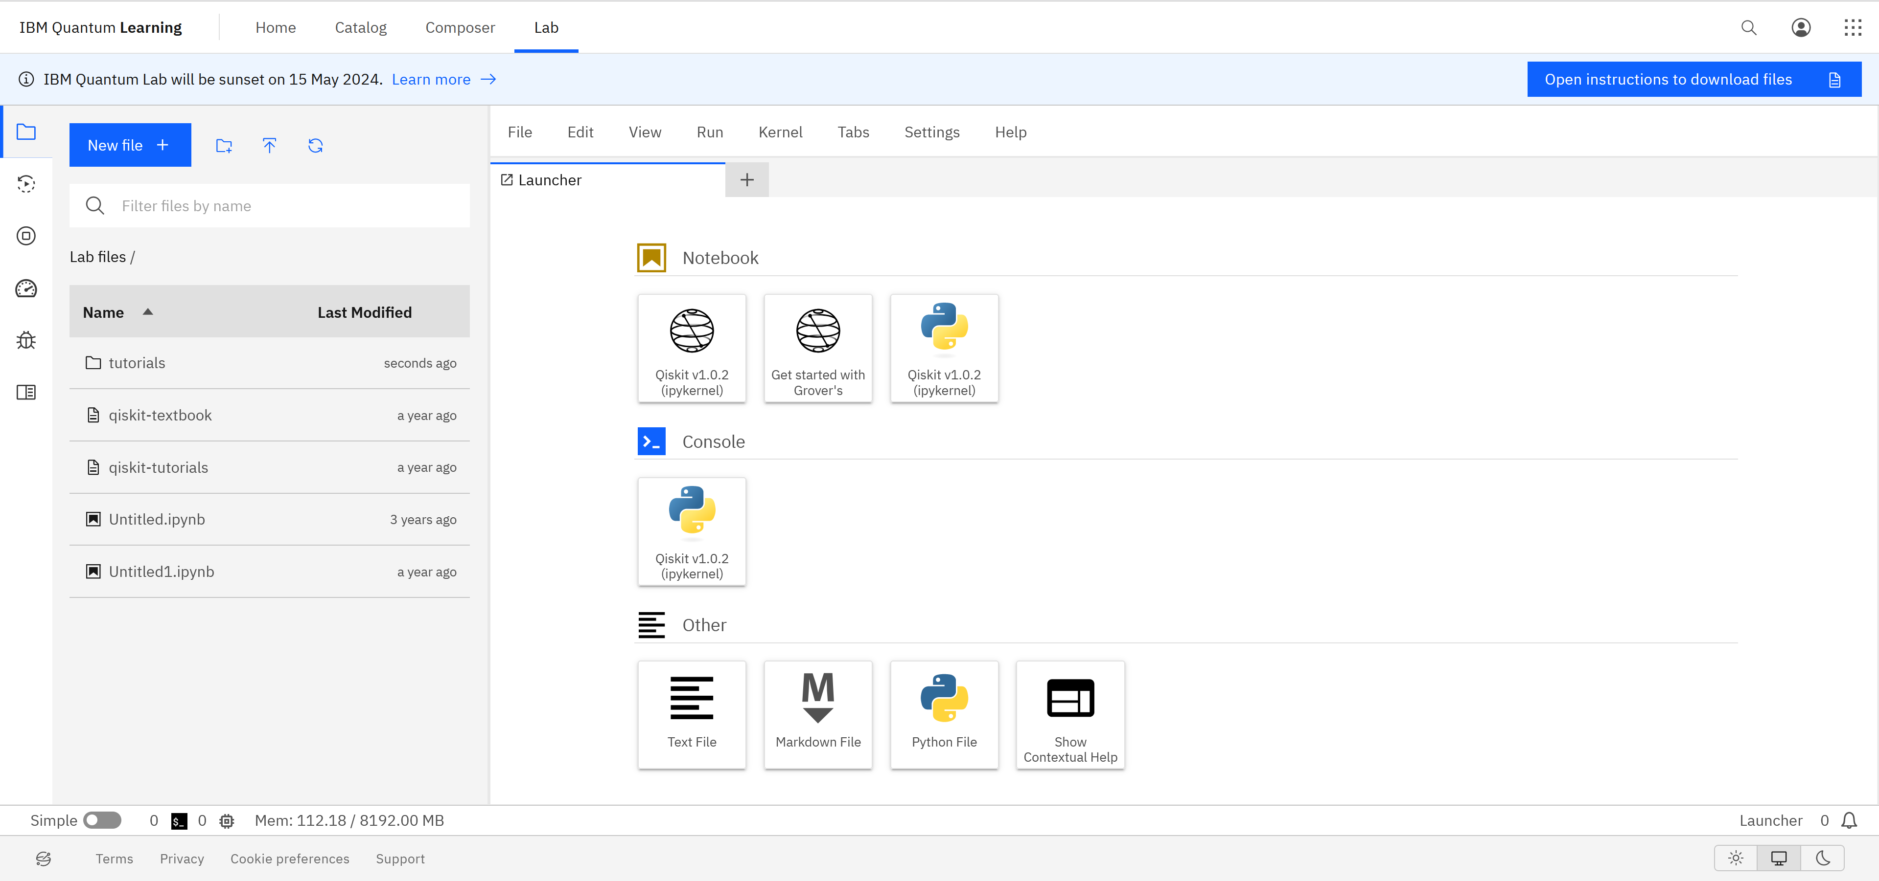
IBM Quantum Lab
IBM Quantum

Slide 36
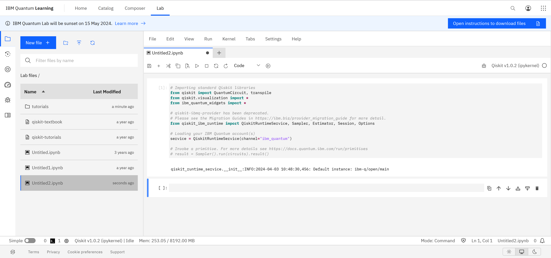
IBM Quantum Lab
IBM Quantum

Slide 37

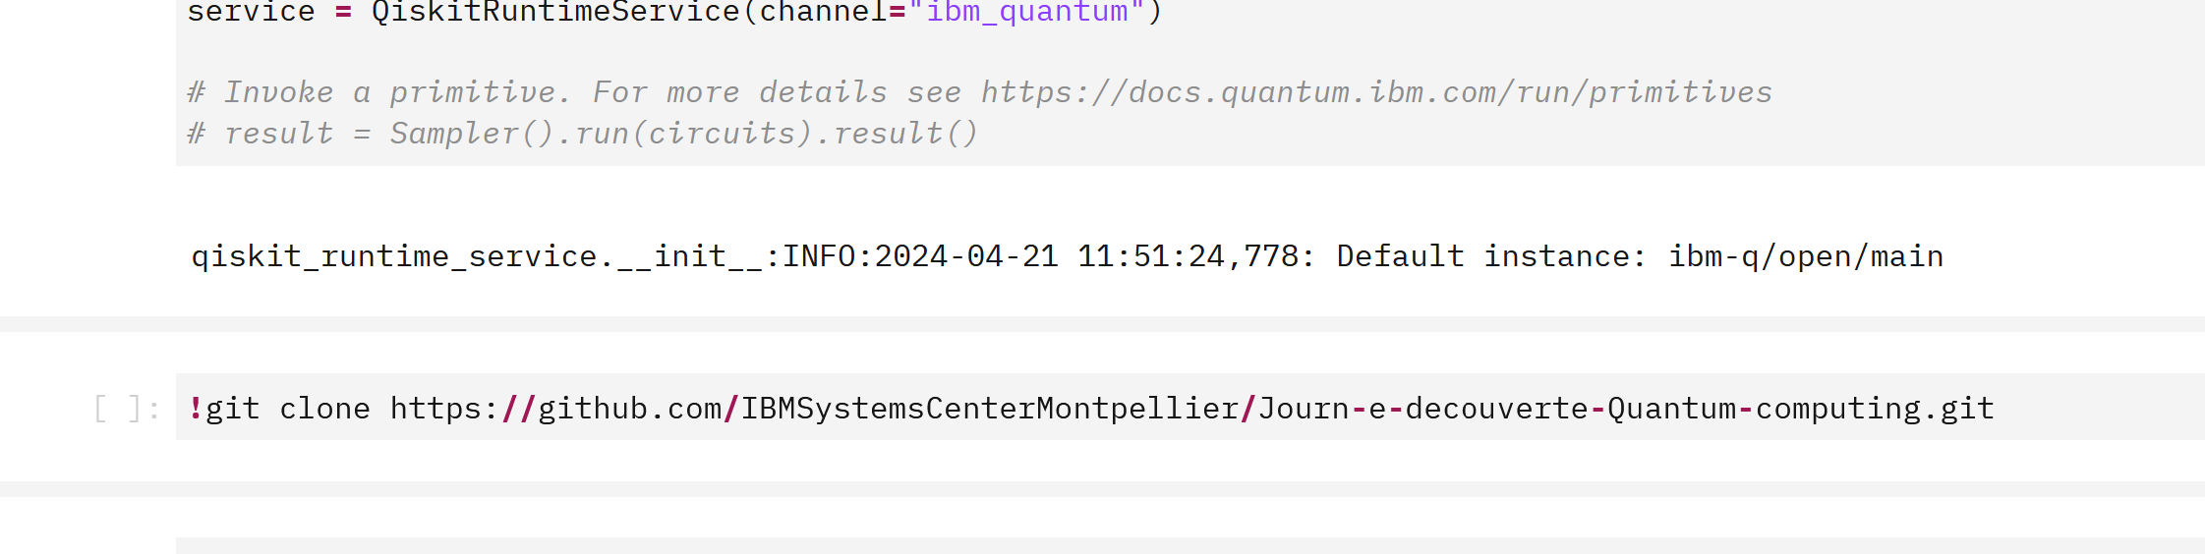
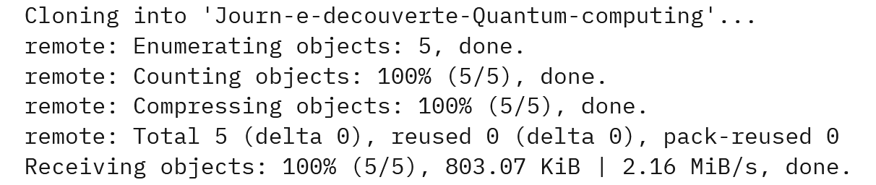
IBM Quantum Lab
IBM Quantum

Slide 38
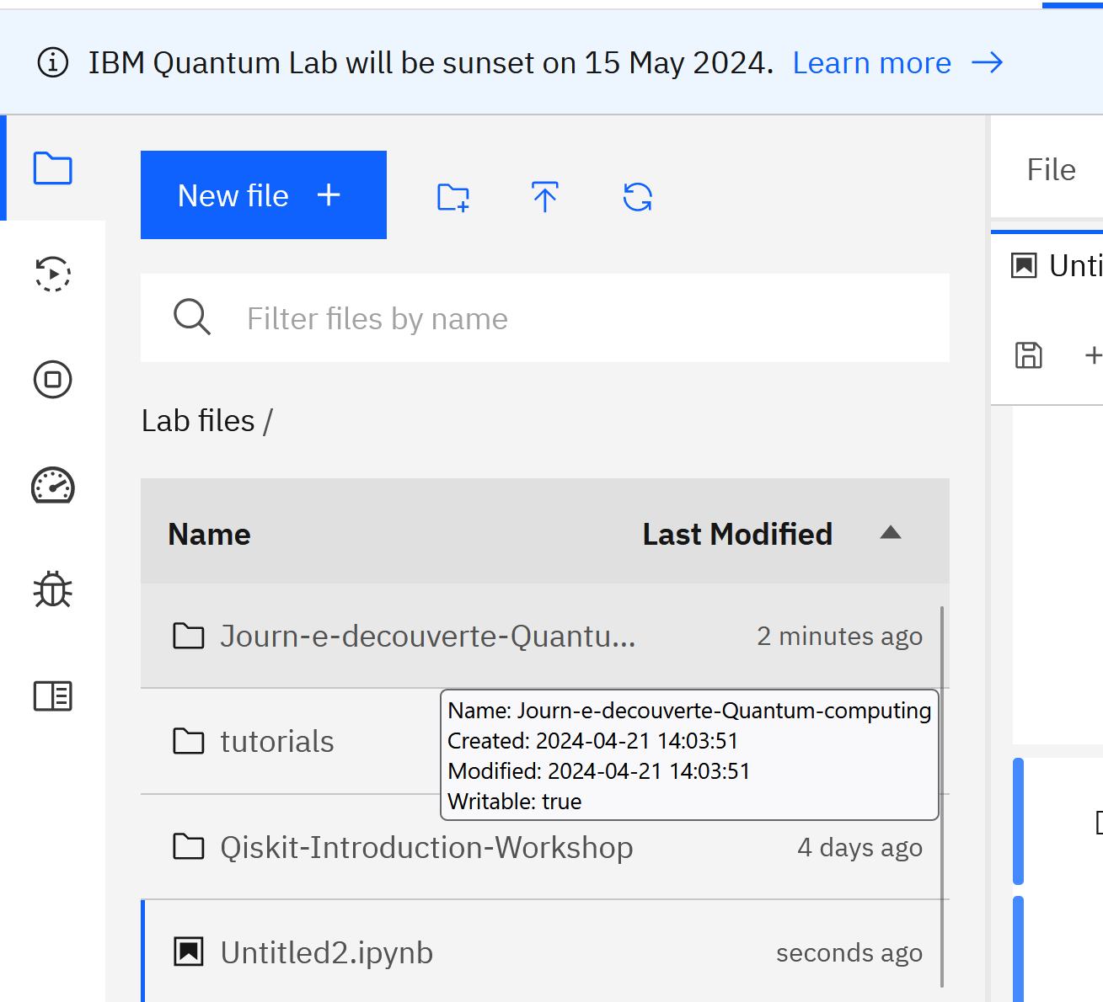
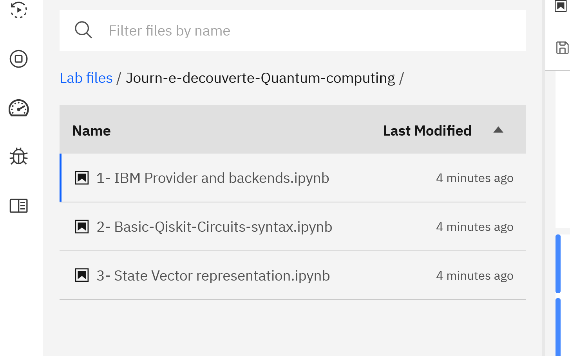
IBM Quantum Lab
IBM Quantum

Slide 40
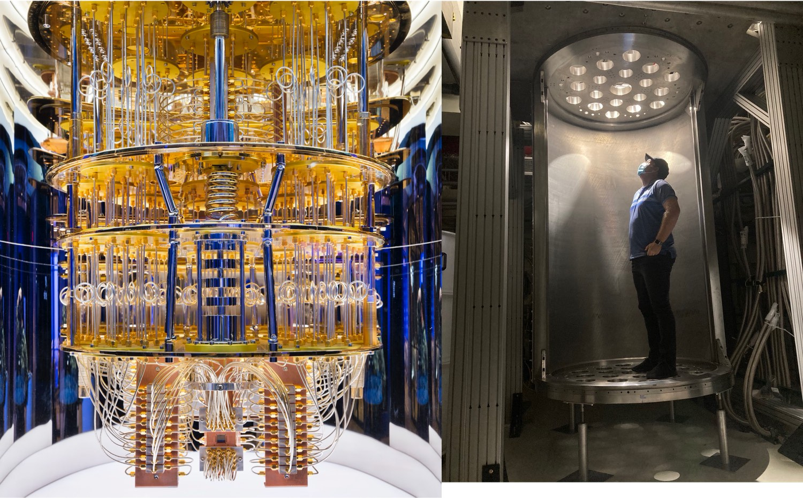
Notes:
Here you can see the difference between our current quantum system, the IBM Q System One on the left. This is approximately 36” tall.
On the right you see the “superfridge”, where our VP/IBM Fellow Jay Gambetta is standing. It will house the upcoming Condor 1,121 qubit processors which we believe will pave the path to 1M qubits and beyond. (Stackable Condors as illustrated in the previous slide)

